Slide 1

Collaborative library networks for a sustainable future
Peter E. Sidorko
The University of Hong Kong
October 5, 2013

Slide 2
Outline
The Information Landscape
Library Collaboration: Tensions and Success
The Hong Kong Situation: Three Collaborative Examples
Deep (Radical) Collaboration and the Role of Technology
Facilitating Collaboration for our Clients
Keys to Successful Collaboration
Conclusions

Slide 3

1 The Information Landscape

Slide 4
Transformational Change in the Information Landscape
Collection Size Rapidly Losing Importance
Traditional Library Metrics Fail to Capture Value to Academic Mission
Rising Journal Costs Inspiring Calls for Alternative Publishing Models
Viable Alternatives to the Library Now Boast Fastest Growth and Easiest Access
Demand Declining for Traditional Library Services
New Patron Demands Stretch Budget and Organizational Culture
From: University Leadership Council, Redefining the Academic Library: Managing the Migration to Digital Information Services, Washington, D.C.: Education Advisory Board, 2011.

Slide 5

2 Library Collaboration:
Tensions and Success
http://www.flickr.com/photos/lumaxart/2137737248/

Slide 6
“Civilization exists within the context of … irresolvable tension born of compromise. To reap the benefits of a civilized existence, we need to curb certain natural tendencies. Library consortial activities … embody and reveal several irresolvable tensions.“
    Peters, Thomas A. “Consortia and their discontents.” Journal of Academic Librarianship, 29:2 111-114, March 2003

Slide 7
Typical obstacles to collaboration
“rivalry and competition, mistrust and jealousy, politics and personalities, different institutional priorities and indifferent institutional administrators, unequal development and parochialism … negative attitudes, such as skepticism, fear of loss, reluctance to take risks, and the pervasive lack of tradition of cooperation”
  Fe Angela M. Verzosa, The future of library cooperation in Southeast Asia, p.7, 2004 Asian Library and Information Conference (ALIC), 21 -24 November, 2004. Bangkok, Thailand

Slide 8
Collaboration Networks
Librarians
Libraries
Faculty
Curriculum designers
Students
Museums
Student support services
Teaching support units
Learning technologists
Pedagogical units
Publishers
Community
Technology vendors

Slide 9
















Slide 10
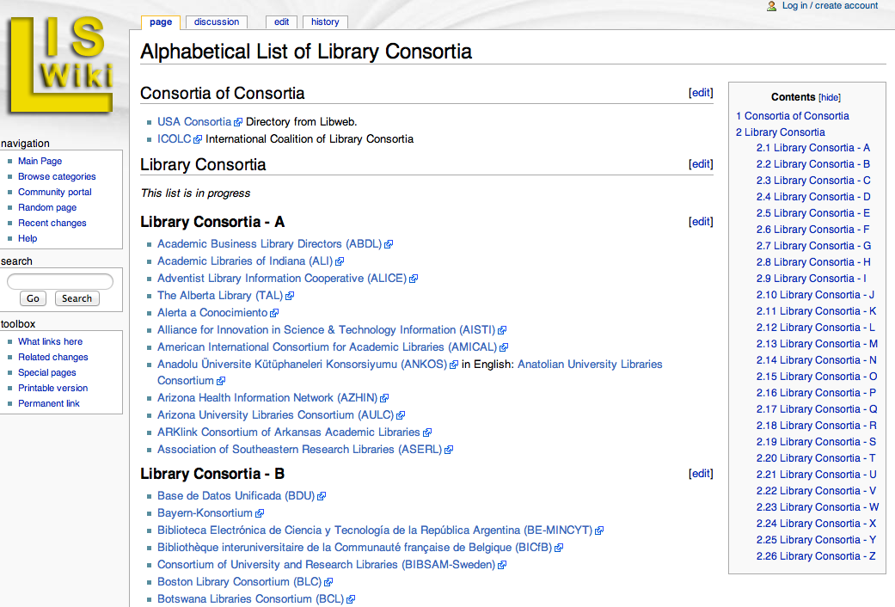

Slide 11
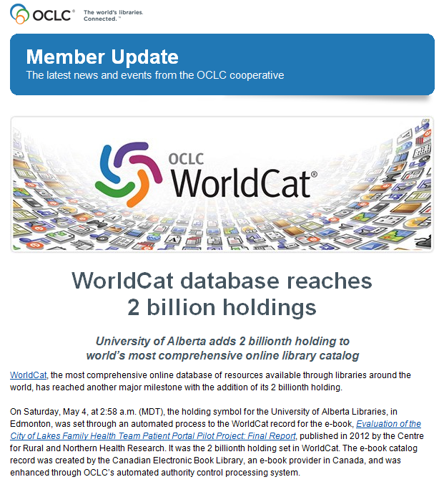
The power of
collaboration

Slide 12
HKU Cataloging output
Top 3 original catalogers in OCLC since 2004
Year | Rank
2004 | 2
2005 | 3
2006 | 1
2007 | 2
2008 | 2
2009 | 1
2010 | 1
2011 | 2
2012 | 1

Slide 13
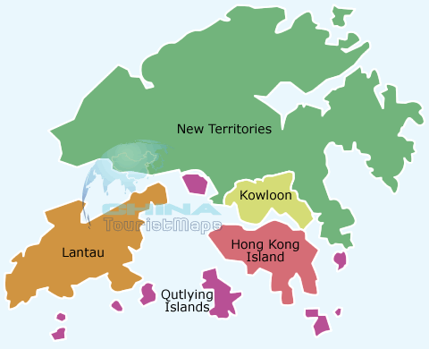
3 The Hong Kong Situation

Slide 14
Hong Kong Higher Education
8 government funded institutes of higher learning (UGC)
3 ranked in the top 50 in the world – HKU (26); HKUST (34); CUHK (39) - (QS Rankings, 2013)
Four year curriculum commenced September 2012 – double cohort 3 year and 4 year programs in parallel
Double 1st year intake for each institution
Estimated total students now 86,000
Desire to be THE Asian education hub
Desire for deep collaboration among the 8
HUCOM (Heads of Universities Committees)

Slide 15
Hong Kong UGC Funded Universities
Chinese University of HK (CUHK)
City University of HK (CityU)
HK Baptist University (HKBU)
HK Institute of Education (HKIEd)
HK Polytechnic University (PolyU)
HK University Science & Technology (HKUST)
Lingnan University (LU)
University of Hong Kong (HKU)

Slide 16

Joint University Librarians Advisory Committee
Founded in 1967
A forum to discuss, co-ordinate and collaborate on library information resources and services among the libraries of the eight tertiary education institutions of the University Grants Committee (UGC) of HKSAR

Slide 17
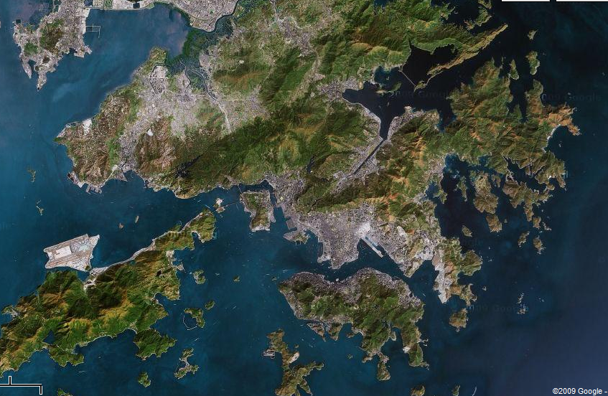









Slide 18
Why Co-operate?
Common resource and service challenges
Geographical and logistical opportunities
Benefit for staff/student communities of each institution
Potential cost-efficiency – saving money
Potential cost-effectiveness – likely to obtain a greater benefit if resources are pooled
Realization of innovative services through common effort and shared expertise
Potential support and funding from government
Likelihood of support from individual institutions

Slide 19
JULAC Principles of Co-operation – 1
Clients
  Every student and staff member a customer of all JULAC libraries
Collections & Services
  The collections and services of JULAC libraries represent a combined resource available to all JULAC
Integration
  Aim to provide comprehensive and seamless access to information resources or services at each library

Slide 20
JULAC Principles of Co-operation - 2
Strategic Fit
  JULAC programs aim to extend, enhance and supplement the resources and services of individual libraries. Programs must be aligned with the overall strategic objectives of both JULAC and the participating member libraries
Consensus
  A program is pursued by JULAC only if at least 6 of the 8 member libraries are in support
  Individual libraries may choose not to participate in all programs based on needs, priorities and circumstances

Slide 21
JULAC Principles of Co-operation – 3
Participation
  Commitment to JULAC programs entails active participation of Directors and staff of each library (eg: Committee membership)
Funding
  Programs will be jointly funded according to their anticipated level of use by each institution and the size/capacity of the institution

Slide 22
JULAC Organizational Structure
JULAC Directors Meeting
Access Services Committee
Consortiall
Bibliographic Services Committee
JURA Working Group
Statistics Committee
Learning Strategies Committee
Systems Committee
Committee on Media
Copyright Committee
Staff Development Committee
Preservation and Conservation Committee
JULAC Project Manager

Slide 23
Three collaborative examples:
Building, sharing and storing resources

Slide 24
(A) Building resources: JULAC Consortiall
Consortial electronic database acquisitions
Consortial monograph acquisitions – HKMAC (Hong Kong Monograph Acquisitions Tender)
E-book acquisitions –
ERALL (Electronic Resources Academic Library Link)
Inter-Regional e-book consortia
Perpetual Access and Escrow-CLOCKSS

Slide 25
JULAC Consortium Development
Leverages member libraries’ collective purchasing power to obtain savings on e-databases and e-journals
Libraries propose products to negotiate - two or more libraries can form a consortium
Over 140 consortia have been formed
Non UGC affiliates may join to increase spending power (15 affiliates in Hong Kong and Macau)
Flexibility and equity in the packages negotiated

Slide 26
(B) Sharing Resources:
JULAC Access Services Committee
Library Access
Undergraduate & above reader access to JULAC libraries. (123,046 visits 2012/13)
Library Borrowing & Inter Library Loans
Postgraduate & Staff “in-person” borrowing from JULAC libraries (47,352 loans & ILL, 2012/13)
HKALL (Hong Kong Academic Library Link)
Local unmediated book request and delivery service (149,632 loans, 2012/13)
Document Delivery & RAPID
Overseas and local unmediated article level request and delivery service.
(8,703 requests 2012/13) – (5,375 RAPID = 62%)

Slide 27
Principles of Co-operative Inter-lending
Shared financing & balanced cost-sharing formulae
Common agreed policies and procedures
Common systems and catalogue access
Strong IT infrastructure
Logistics & transportation (local delivery)
Load balancing
Flexibility and restrictions on access allowable

Slide 28
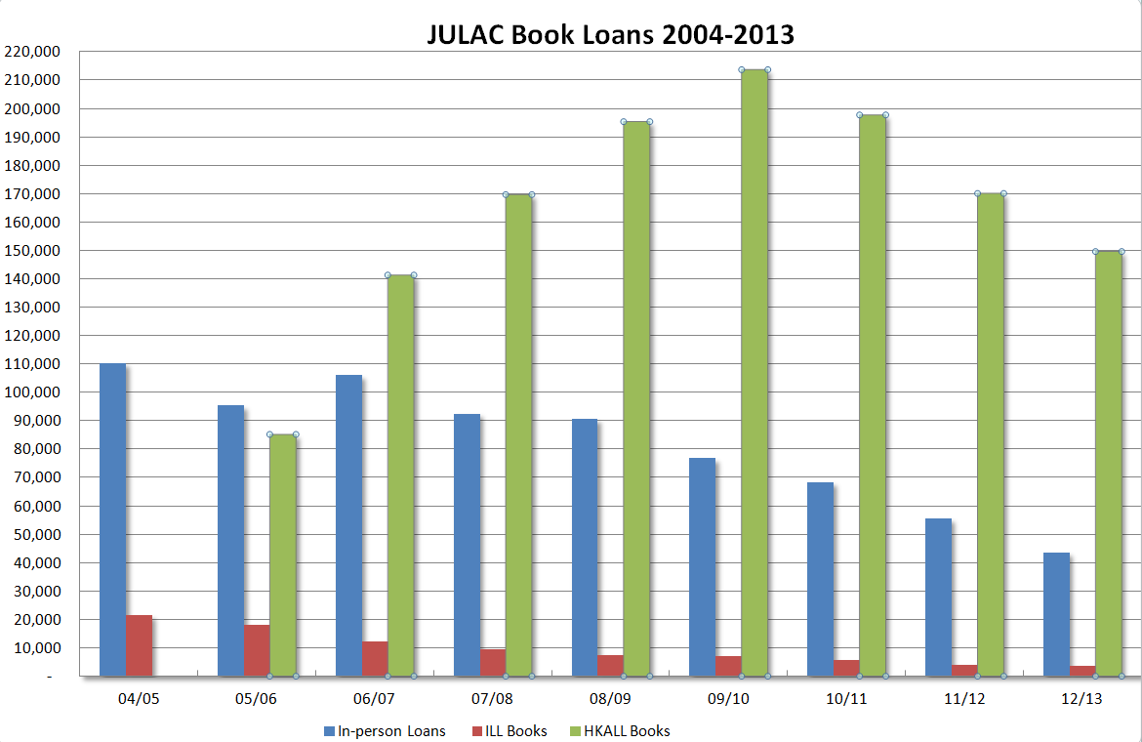

Slide 29
HKALL introduced

Slide 30

What is HKALL
Hong Kong Academic Library Link
A user initiated (unmediated) ILL service
A Hong Kong implementation of III’s (INNOVATIVE’s) INN-Reach system
Notes:
When first introduced the name itself was controversial

Slide 31
Why?
Positive experiences in the USA
Changes to Higher Education in Hong Kong
  Demographics
  Economy
  Impact of technology
  Reduced funding
  Desire for “deep collaboration” among the eight
Geography
Notes:
Geography
The implementation of a user initiated interlibrary loan service seemed by many to be an idea made for Hong Kong. Geographically, Hong Kong is small. Situated in Eastern Asia, bordering the South China Sea and mainland China, it covers 1,092 sq km (approximately three times the size of Malta, twice the size of Monaco or less than twice that of Singapore). With eight government funded universities contained within this small area, the timely delivery of materials between campuses struck many as a reality whose time had come.

Slide 32
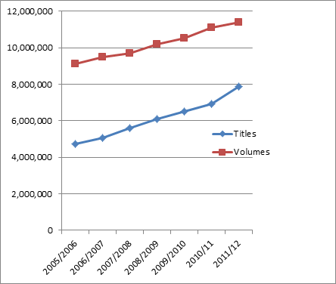
HKALL Size

Slide 33

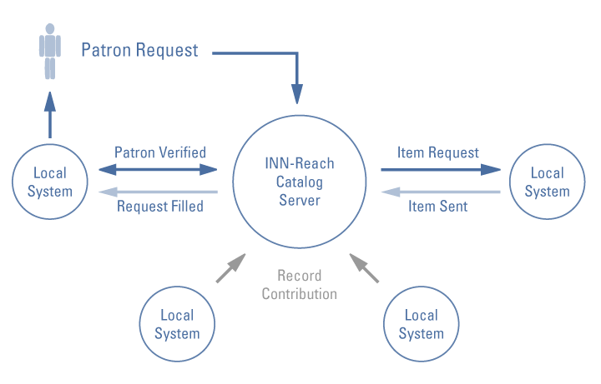
Reproduced from Innovative Interfaces:
<http://www.iii.com/innreach/index.shtml#systemmgmt>

Slide 34
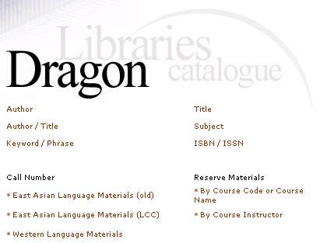
How HKALL Works
Scenario 1: A book is not owned by the local library

Slide 35
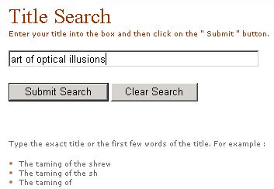

Slide 36
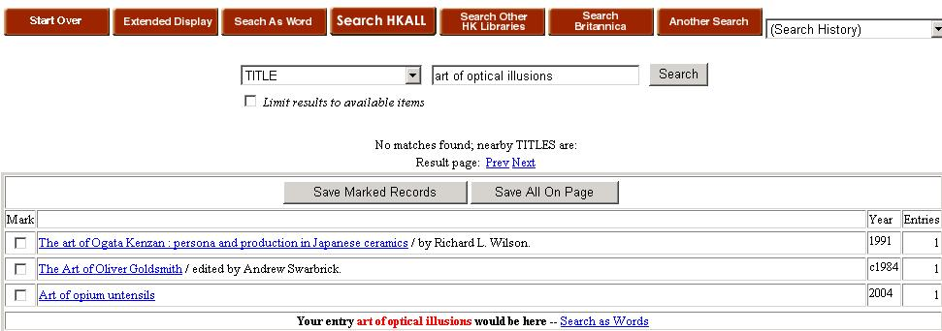
We do not have this title in our library. We search HKALL

Slide 37
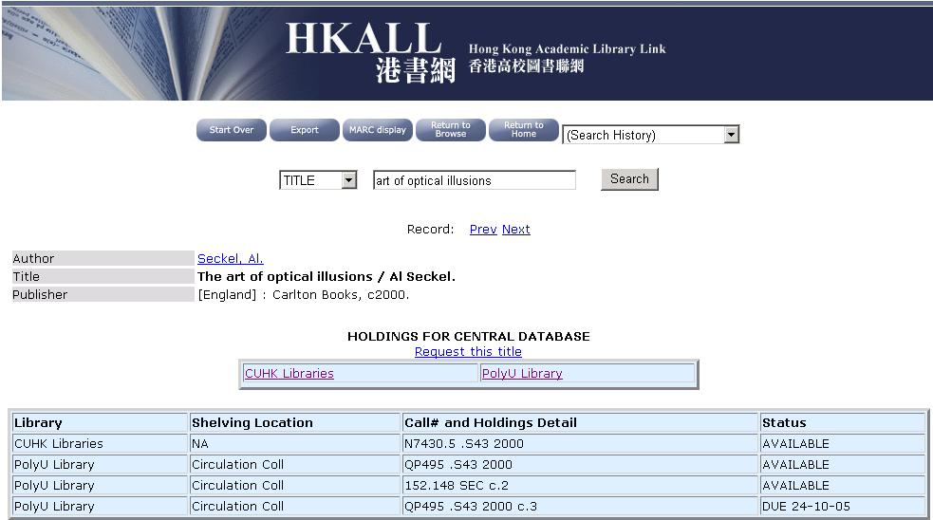
Copies available at both CU and PolyU

Slide 38
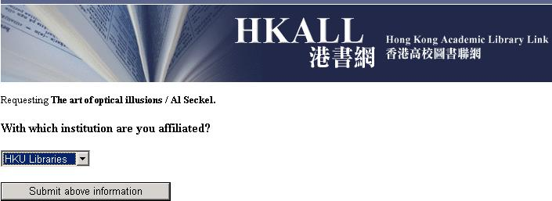
Make request

Slide 39
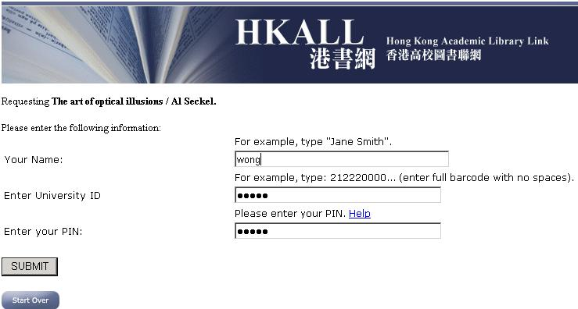
Authenticate against local patron database

Slide 40
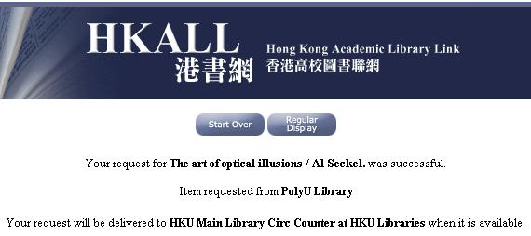
Title successfully requested!

Slide 41

Patron receives email pickup notice after the book is transferred to the borrowing site

Slide 42
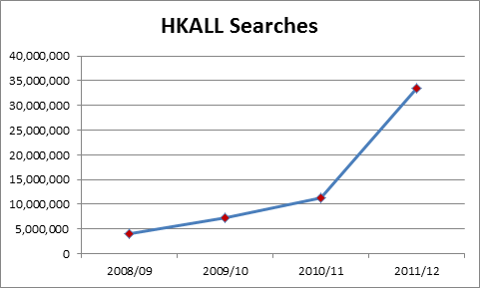

Slide 43
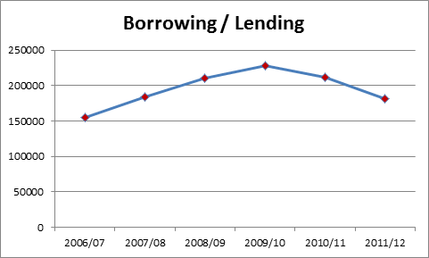

Slide 44
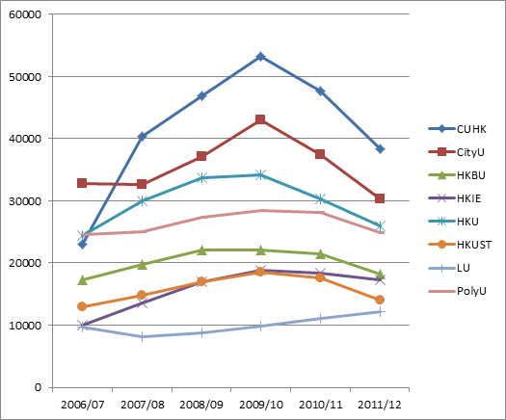
Borrowing

Slide 45
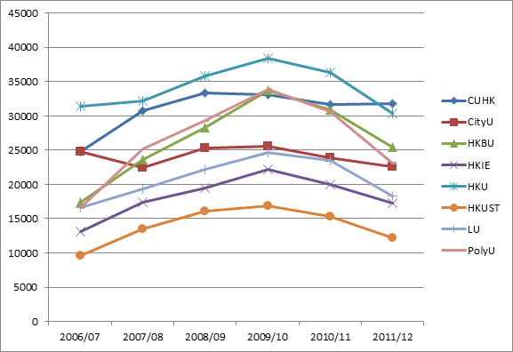
Lending

Slide 46
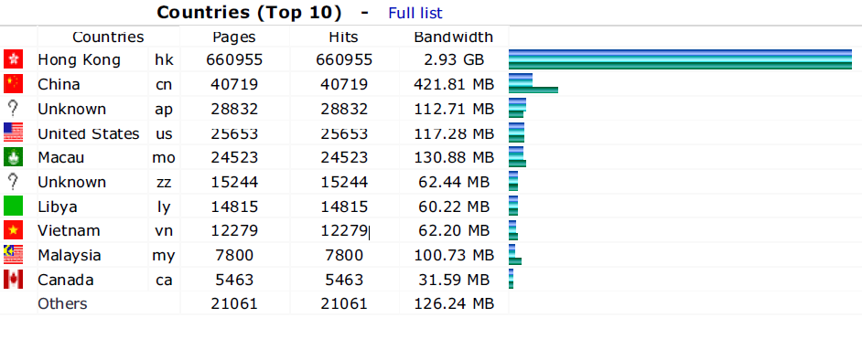
January 2012

Slide 47
INN-Reach Requests per Library
INNReach System | Libraries | Total Requests | Requests per Library
Hong Kong ALL | 8 | 221,348 | 27,669
Prospector | 25 | 670,719 | 26,829
SearchOhio | 17 | 418,043 | 24,591
LINK+ | 45 | 583,621 | 12,970
Mobius | 14 | 178,645 | 12,760
The Circuit | 5 | 52,496 | 10,499
OhioLink | 87 | 804,022 | 9,242
Busiest INN-Reach in the World!

Slide 48
Adding It up…
January-December 2009
Requests | 221,348
Fulfillments | 207,164
Fill Rate | 93.6%
Dollar Value of Shared Material | $10,358,200 USD*
Dollar Value per Library | $1,294,775 USD*
*Based on an average of $50 USD to purchase, process and shelve a book
  Request rate shows how important HKALL is to users.
  Fill rate illustrates libraries’ committed partnership.
Over 200,000 fulfillments in 2009!
That’s over $10 million USD worth of material!

Slide 49

(C) Storing resources:
JULAC “JURA” Co-operative Storage
Joint Universities Research Archive (JURA) Inc.
Co-operative research collection, single copies of items from UGC university libraries
Space and construction savings at each university library
Initial capacity of 6.3 million volumes and Projected capacity of 9.95 million volumes, to 2030
Equal institutional shares in ownership of facility
Shared operating costs

Slide 50
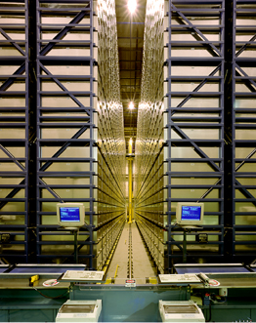
Automated Storage & Retrieval System
A random-access
robotic storage & retrieval system

Slide 51
Materials kept in bins
59,000 metal bins
(1.2 x 0.6m).
4 different heights: 20cm (4%), 26cm (49%), 31cm (42%), 39cm (5%)
Bins will be divided into sectors.

Slide 52
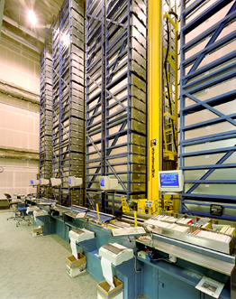
4 aisles, each with own crane on 2.5 floors.
Each module is 35 -40 tiers high.
2 workstations per aisle with barcode scanners & printers.

Slide 53
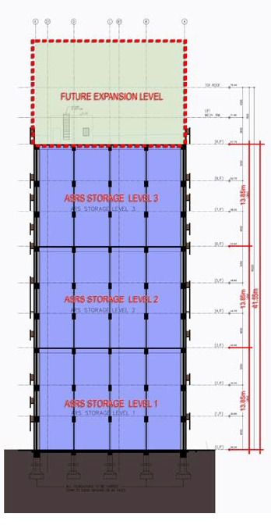
A 12 Storey Building
4 stories high ultimately but initially only 3
1 JURA storey = 3 regular floors
So ultimately like a 12 storey building

Slide 54
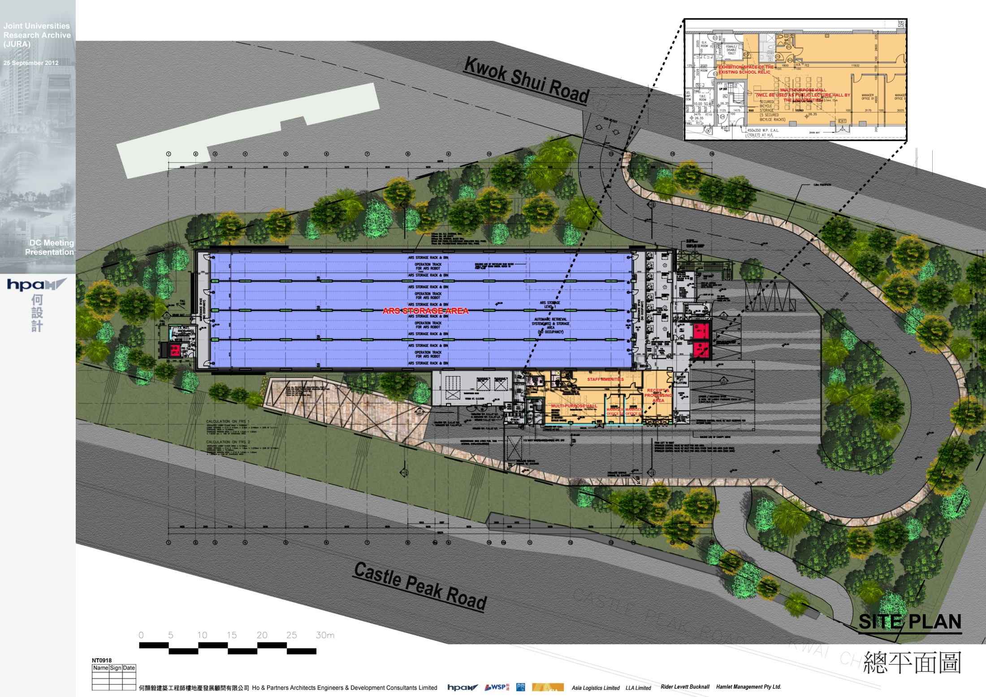

Slide 55
Location
JURA

Slide 56
Progress to date
Completion of the detailed design report;
Incorporation of the eight JULAC Librarians into a company (JULAC Joint Universities Research Archive Limited), a pre-requisite by the Government before land can be allocated for the building of the facility;
The JURA Board of Directors has developed a twelve month action plan;

Slide 57
Progress to date (cont.)
Preliminary research into robotic storage systems with likely startup costs and annual maintenance;
In principle agreement for the leasing of land for JURA;
Government did not raise priority status of the project – next announcement this month.

Slide 58
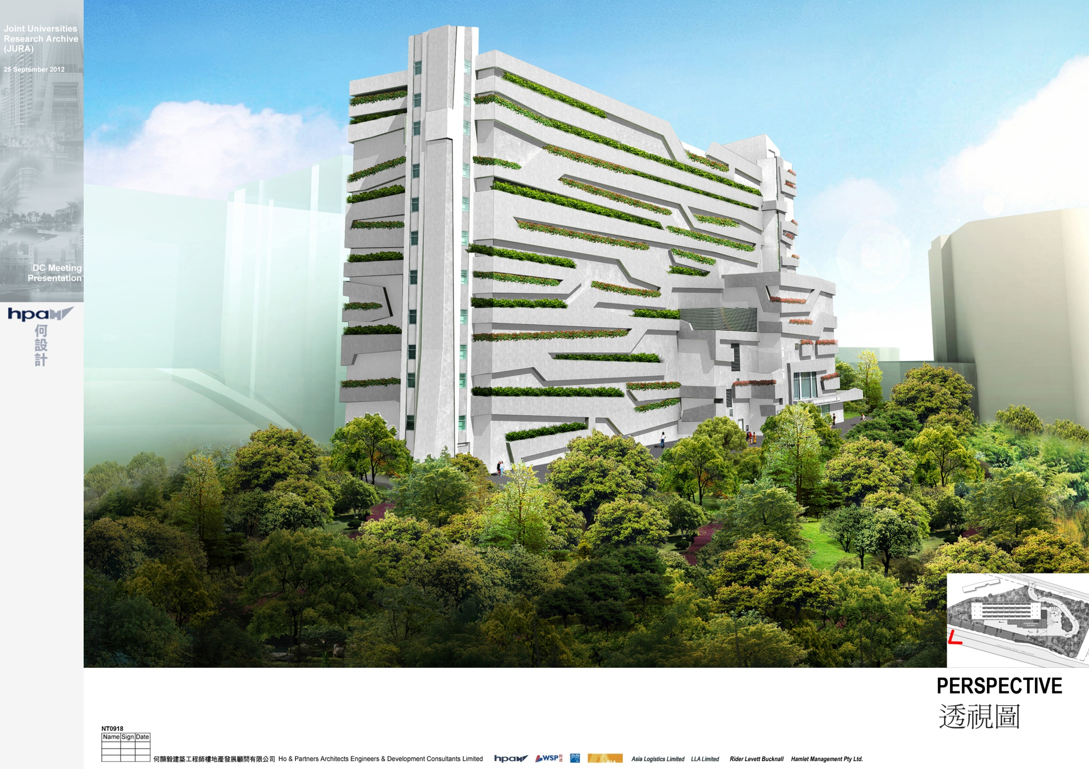

Slide 59
Obstacles to JURA collaboration
Metrics – perceived library status
Funding
Physical access
Geography
Competition vs collaboration
Faculty reactions
Institutional commitments
And the usual collaboration issues…

Slide 60

JURA: A catalyst for change?
Commitment
Common, new goals: strategic
Common, new goals: operational
  Cataloguing and bibliographic services
  Processing
  Digitisation
  Digital repository

Slide 61
JURA: A catalyst for change?
Better and more coordinated planning efforts
  Joint strategies
  Evaluation, qualitative and quantitative, RoI
Better communication, across multiple levels
Strengthened alliances: unified and targeted
Catalyst for change – intra and extra

Slide 62
JURA: A catalyst for change?
Better knowledge of our own collection(s), and each others
Improved collection development
Greater innovation
Transformation of existing spaces for new user needs or trading/returning space to the campus for other priorities.

Slide 63
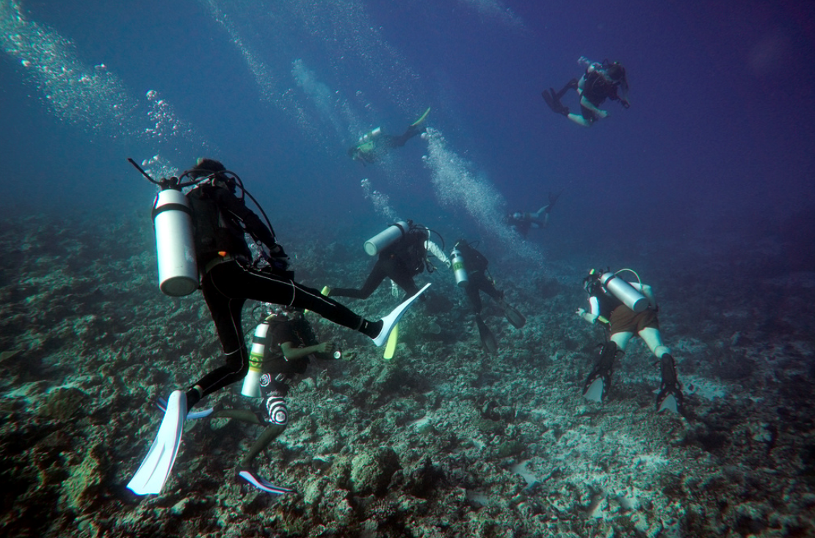
4 “Deep” Collaboration
Malcolm Brown http://www.flickr.com/photos/69362954@N00/6980738549/

Slide 64
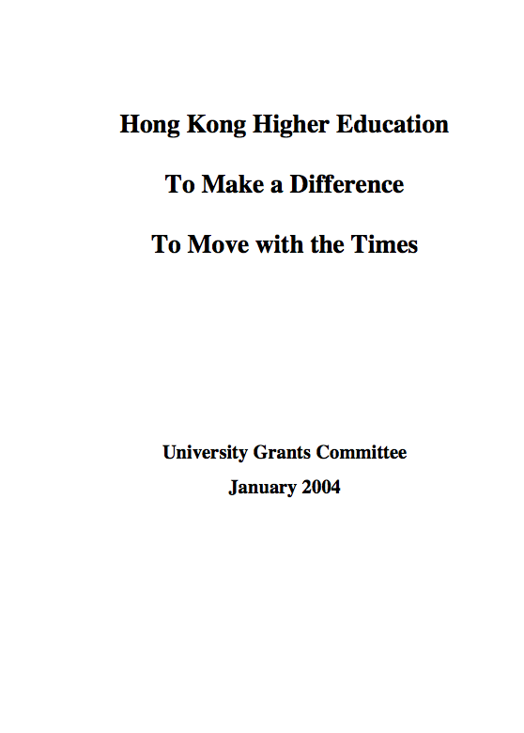
HK’s University Grants Committee:
… values a … deeply collaborative system of higher education where each institution …(is) committed to extensive collaboration with other institutions
… is setting aside funding to support deep collaboration … that will not be granted unless such collaboration takes place
http://www.ugc.edu.hk/eng/doc/ugc/publication/report/policy_document_e.pdf

Slide 65
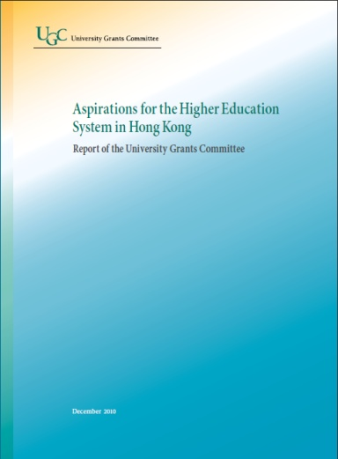
UGC Report December 2010
“We are thus, in general, disappointed at the level of collaboration … There are, however, areas of success: … the collaboration by libraries on a new joint storage facility and sharing of books.”

Slide 66
Deep collaboration?
Clearly defined, shared vision among participants
Greater level of engagement, time commitments, and goal alignment
Higher levels of responsibility, risk, and commitment
Optimization of information resources, and staff resources
Significant imagination and perseverance

Slide 67
Deep collaboration?
Ability to adapt and change as the process evolves and deepens
Reciprocity and congeniality, and staff skilled in negotiation and compromise
Shared power and decision making.
From: V. Horton, Going “All-in” for Deep Collaboration,
Collaborative Librarianship, 5(2), 65-69 (2013).
available at http://www.collaborativelibrarianship.org

Slide 68
Transformational Change in the Information Landscape
Collection Size Rapidly Losing Importance
Traditional Library Metrics Fail to Capture Value to Academic Mission
Rising Journal Costs Inspiring Calls for Alternative Publishing Models
Viable Alternatives to the Library Now Boast Fastest Growth and Easiest Access
Demand Declining for Traditional Library Services
New Patron Demands Stretch Budget and Organizational Culture
From: University Leadership Council, Redefining the Academic Library: Managing the Migration to Digital Information Services, Washington, D.C.: Education Advisory Board, 2011.

Slide 69
Transformational Change in the Information Landscape
Implicit in each of these 6 changes is the impact and role of technology!
Technology is changing the landscape but it now also enables “deeper” collaboration than was previously possible.

Slide 70
The power of
Collaboration
(assisted by
Technology)

Slide 71
University of California
Collaboration is “deeply challenging and very difficult. It raises problems to which … available technologies do not offer ready answers.”
Shared cooperative licensing, Bibliographic access, De-selection, Space management, Financial management, Operating system, Service models, Organisation and administration services
Lawrence, G.S. 2004. Radical Change by Traditional Means:
Deep Resource Sharing by the University of California Libraries,
Serials 17, no. 2: 119-125.

Slide 72
Radical collaboration
“The future health of the research library will be increasingly defined by new and energetic relationships and combinations, and the radicalization of working relationships among research libraries, between libraries and the communities they serve, and in new entrepreneurial partnerships”
  Neal, J.G. Advancing from Kumbaya to radical collaboration: redefining the future research library, in Transforming Research Libraries for the Global Knowledge Society (B.I. Dewey (ed.), Oxford: Chandos, 2010 (p. 13).

Slide 73
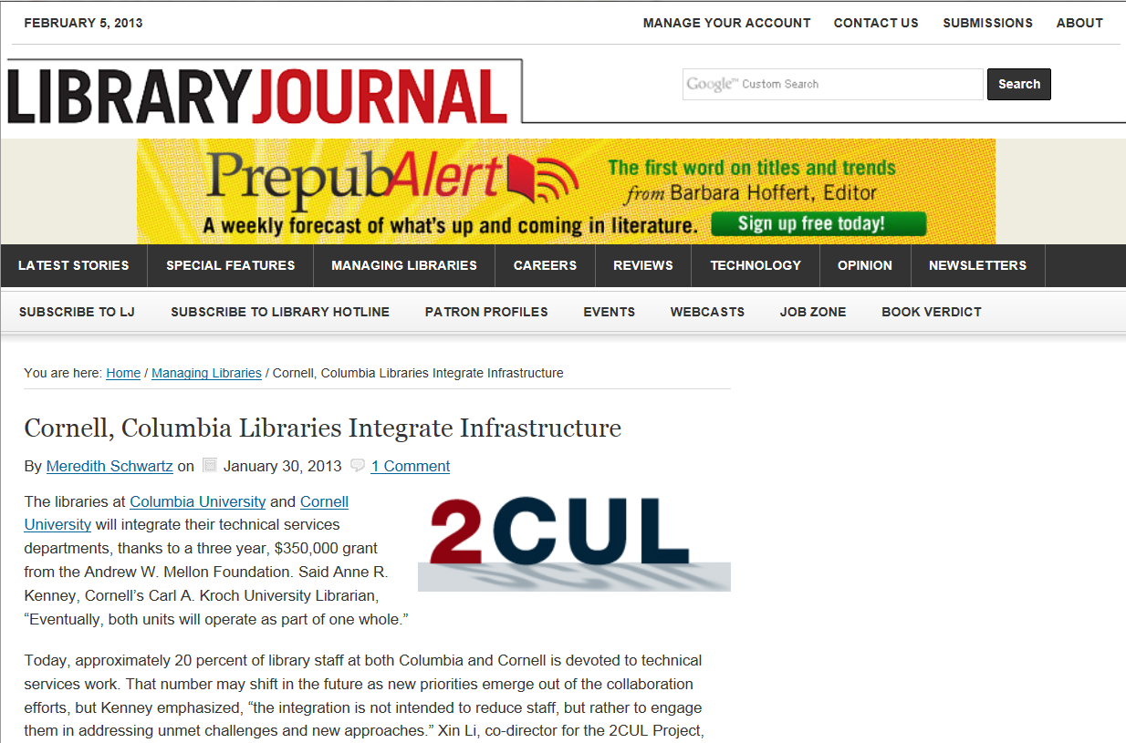
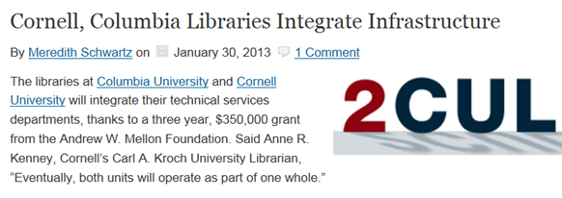
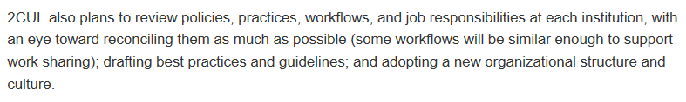

Slide 74





“OCLC’s cloud-based library management services enable libraries to share infrastructure costs and resources as well as to collaborate in new ways”

Slide 75
Possible areas for deep collaboration
Collection building – distributed collection profiles
Acquisition processes
Cataloguing
Preservation and conservation
Binding
Reference
Storage

Slide 76
JULAC Strategic Plan

Slide 77
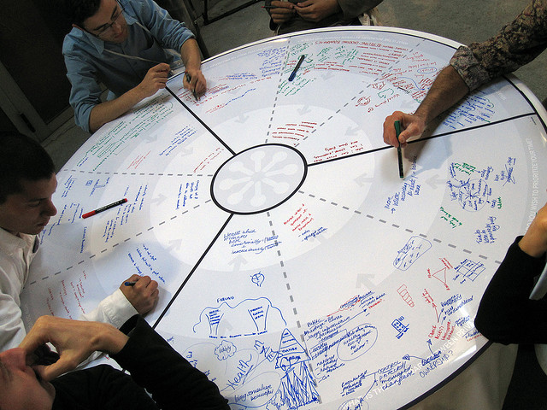
5 Facilitating collaboration for clients: The Rise of the CRIS
(Current Research Information System)
http://www.flickr.com/photos/jenlen/4087508548/

Slide 78
IR ➔ CRIS
…a database or other information system storing data on current research …
for researchers: easy access to relevant information
for research managers and administrators: easy measurement and analysis of research activity and easy access to comparative information
for research councils: transparency and optimisation of the funding process
for entrepreneurs and technology transfer organizations: easy retrieval of novel ideas and technology and identifying competitors
for the media and public: easy access to information … to allow easily-assimilated presentation of research results in appropriate contexts
  From Wikipedia

Slide 79
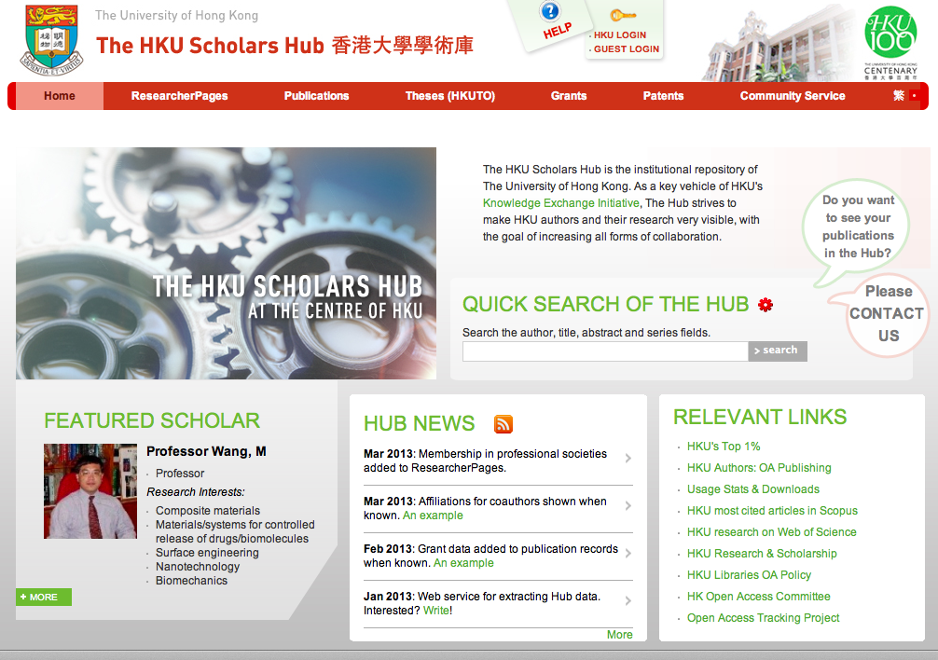

Slide 80
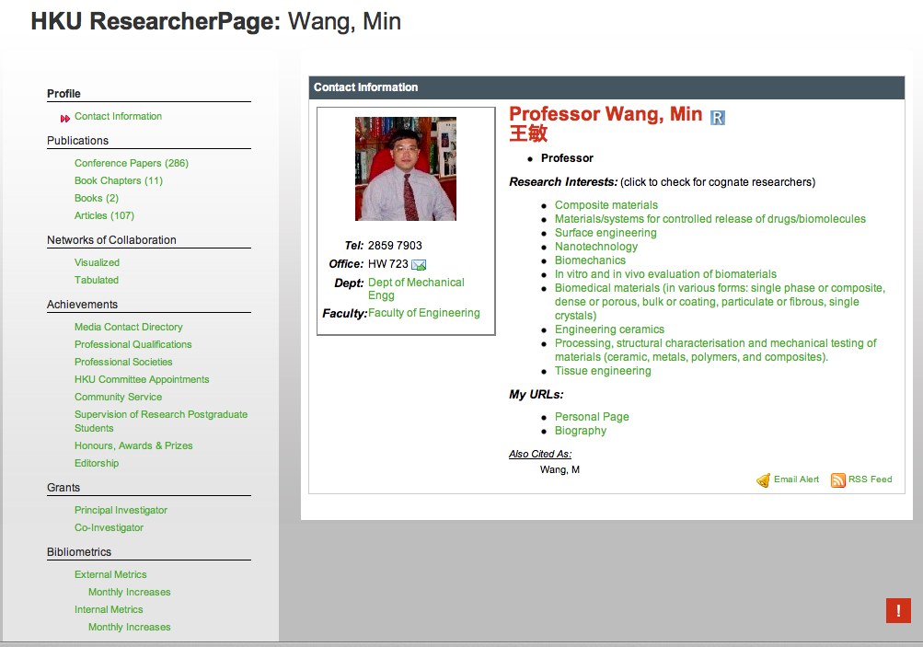

Slide 81
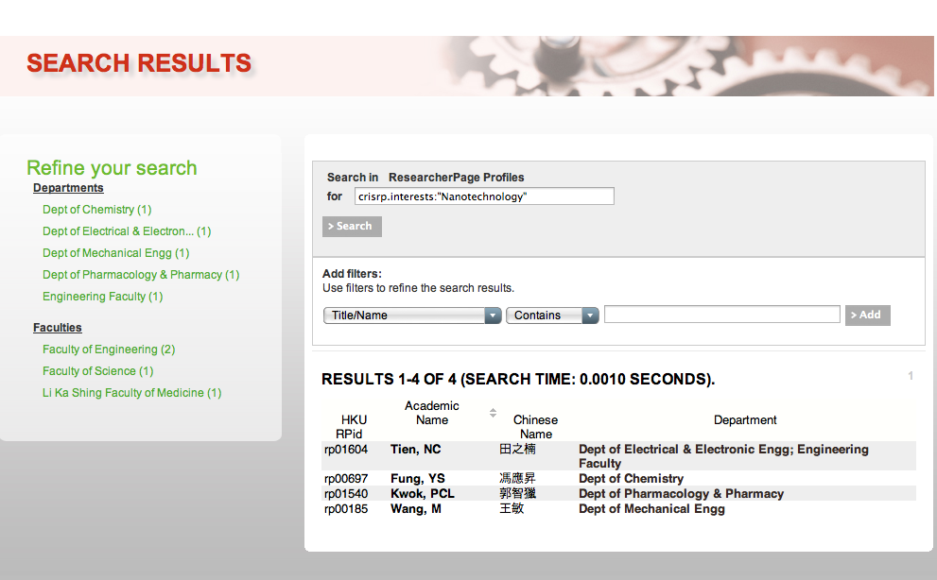

Slide 83
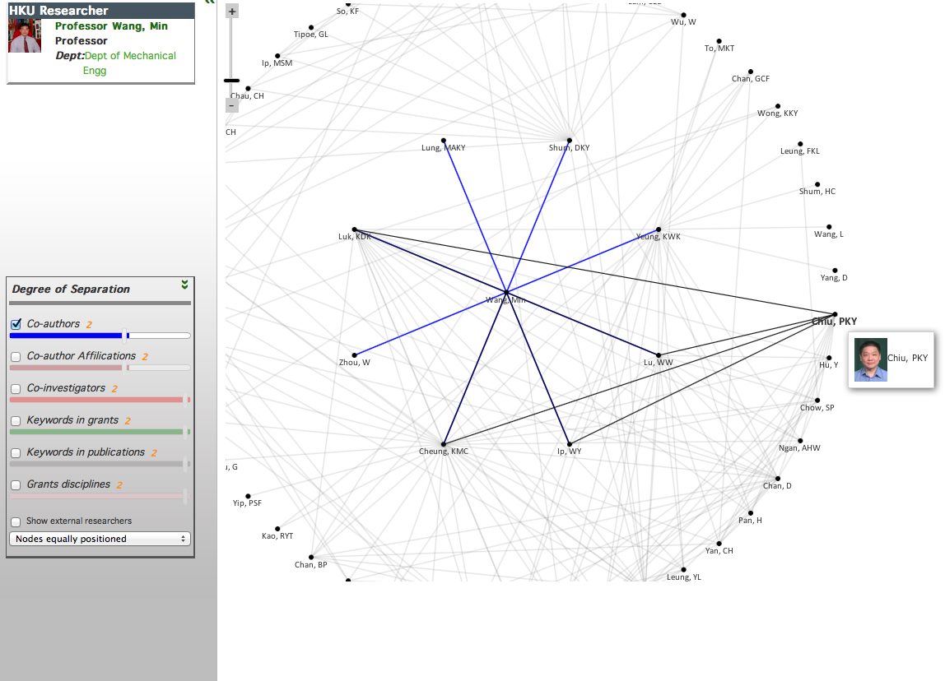

Slide 85
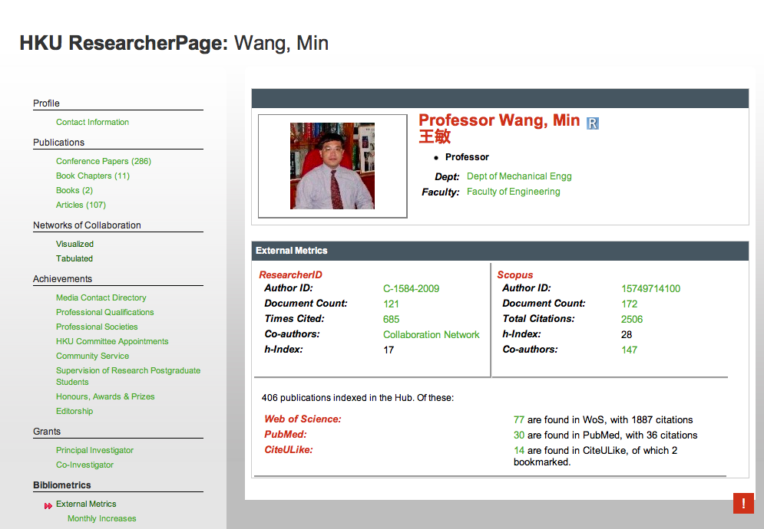

Slide 86
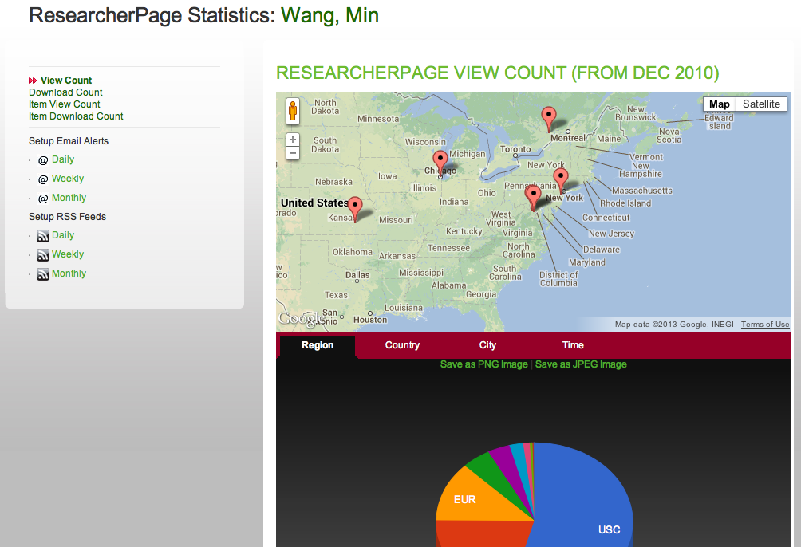

Slide 87
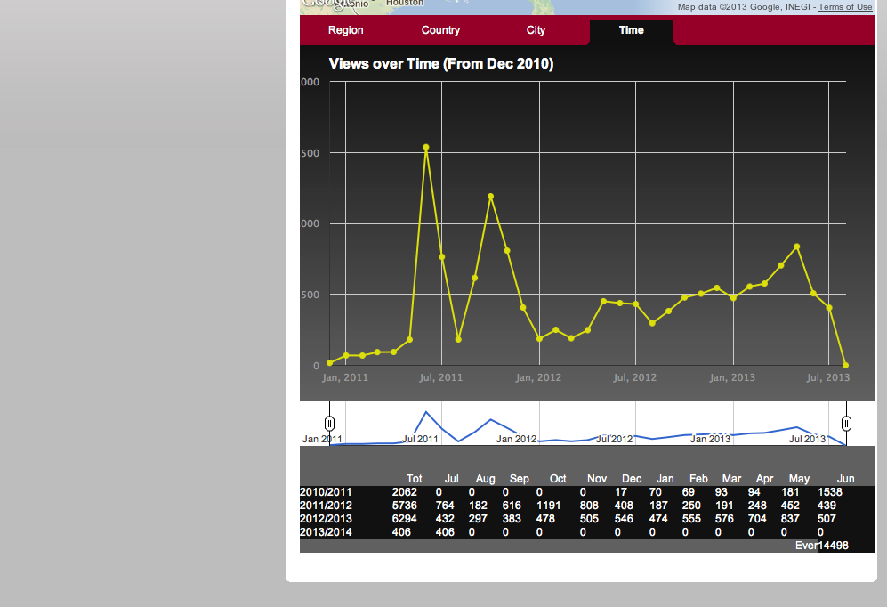

Slide 88

6 Keys to Successful Collaboration

Slide 89
Successful collaborative efforts have:
Benefits for all the participants
Well defined relationships
Common goals
Commitment of the organizations leaders
Several projects with long term effort and results
Comprehensive planning, including:
  - development of joint strategies and
  measures of success i.e. benefits to the user
  mutual risk
Shared resources or jointly contracted
Distributed benefits – more is accomplished jointly than could be individually

Slide 90
Successful collaborative efforts also have:
A recognised need
Positive attitudes
Respect
Communication
Resources
A plan with vision, mission and goals
Technology (some times)

Slide 91
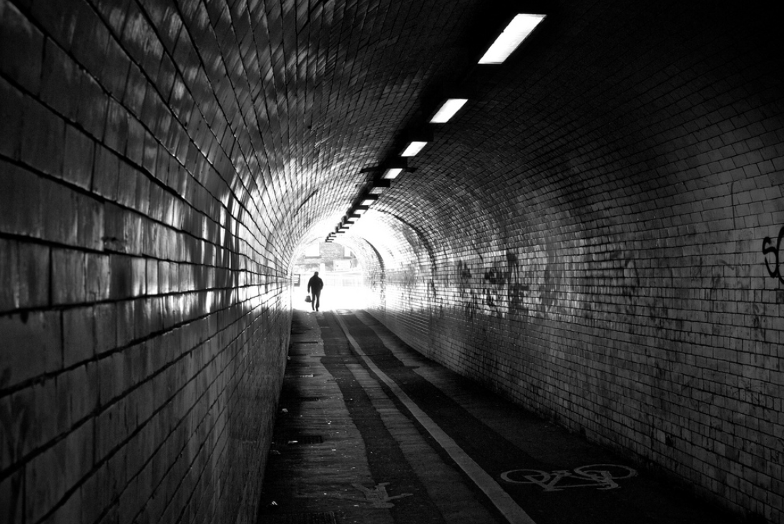
7 Conclusions
Darren Harmon http://www.flickr.com/photos/demonsub/6886684495/

Slide 92
7 Conclusions
Dramatic changes in the information environment require libraries to collaborate
Collaboration must be mutually beneficial
Deeper collaboration is now necessary
Technology can enable deep collaboration
Librarians can be role models and facilitate collaboration for our users.

Slide 93

http://www.flickr.com/photos/jaako/3273714163/sizes/l/in/photostream/
Salam dari Hong Kong dan terima kasih!

