Slide 1
The Open Science Trend and the Role of University Libraries
WS on Next Generation Repositories
April 12, 2018
Miho Funamori
National Institute of Informatics

Slide 2
Outline
What is Open Science?
Policy Developments
Drivers
Challenges of Open Science
Role of University Libraries in Open Science Era

Slide 3
1. What is Open Science?

Slide 4

What is Open Science?
... Science has always been open!

Slide 5

Definition: Open Science
…Umbrella Term
Pre-print
Data-intensive
Citizen science
Open access
Open data
Alternative
reputation systems
Open code
Collaborative bibliographies
Open tab books
/workflow
Science blog
Open annotation
Source: European Commission, “Open Innovation, Open Science, Open to the World—a vision for Europe,” 2016

Slide 6
Definition: Open Science
Said to have no fixed definition
General understanding:
New ways of doing research and organizing science
Enabled through digital technology
Reshaping academic value systems

Slide 7
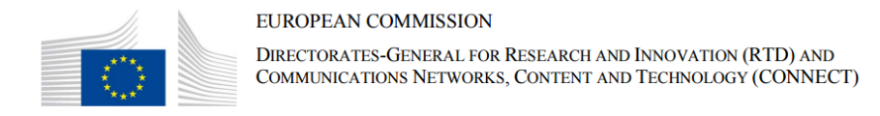
Open Science…European Commission (2014)
…Public Consultation ‘Science 2.0’: Science in Transition
‘Science 2.0’ describes the on-going evolution in the modus operandi of doing research and organising science. These changes in the dynamics of science and research are enabled by digital technologies and driven by the globalisation of the scientific community, as well as the increasing societal demand to address the Grand Challenges of our times. They have an impact on the entire research cycle, from the inception of research to its publication, as well as on the way in which this cycle is organised.

Slide 8
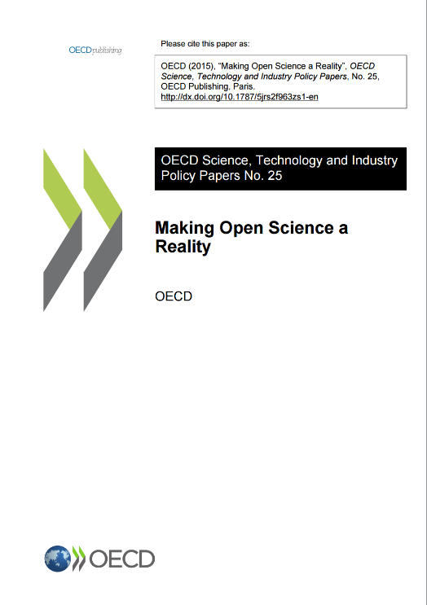
Open Science…OECD (2015)
…Making Open Science a Reality
Open science commonly refers to efforts to make the output of publicly funded research more widely accessible in digital format to the scientific community, the business sector, or society more generally. Open science is the encounter between the age-old tradition of openness in science and the tools of information and communications technologies (ICTs) that have reshaped the scientific enterprise and require a critical look from policy makers seeking to promote long-term research as well as innovation.

Slide 9

Open Science…European Commission (2016)
…Open Innovation, Open Science, Open to the World
Open Science represents a new approach to the scientific process based on cooperative work and new ways of diffusing knowledge by using digital technologies and new collaborative tools. The idea captures a systemic change to the way science and research have been carried out for the last fifty years: shifting from the standard practices of publishing research results in scientific publications towards sharing and using all available knowledge at an earlier stage in the research process.

Slide 10
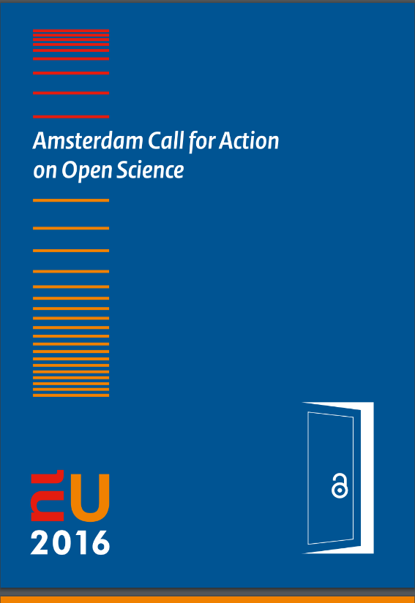
Open Science…European Commission (2016)
…Amsterdam Call for Action on Open Science
Open science is about the way researchers work, collaborate, interact, share resources and disseminate results. A systemic change towards open science is driven by new technologies and data, the increasing demand in society to address the societal challenges of our times and the readiness of citizens to participate in research.

Slide 11
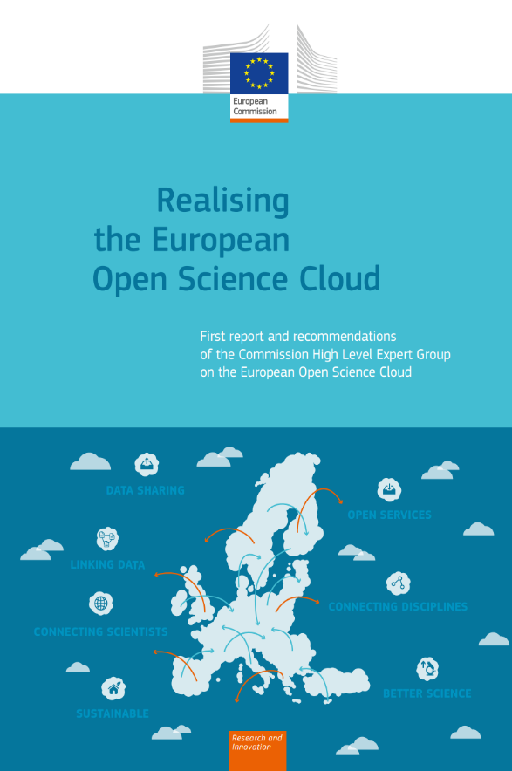
European Open Science Cloud
(EOSC)
EOSC aims to accelerate and support the current transition to more effective Open Science and Open Innovation in the Digital Single Market.
KEY FACTORS:
  New modes of scholarly communication
  Modern reward and recognition practices need to support data sharing and re-use.
  Core data experts need to be trained and their career perspective significantly improved.
  A real stimulus of multi-disciplinary collaboration requires specific measures in terms of review, funding and infrastructure.
  The transition from scientific insights towards innovation needs a dedicated support policy.
Source: European Commission: Realising the European Open Science Cloud
https://ec.europa.eu/research/openscience/pdf/realising_the_european_open_science_cloud_2016.pdf#view=fit&pagemode=none

Slide 12
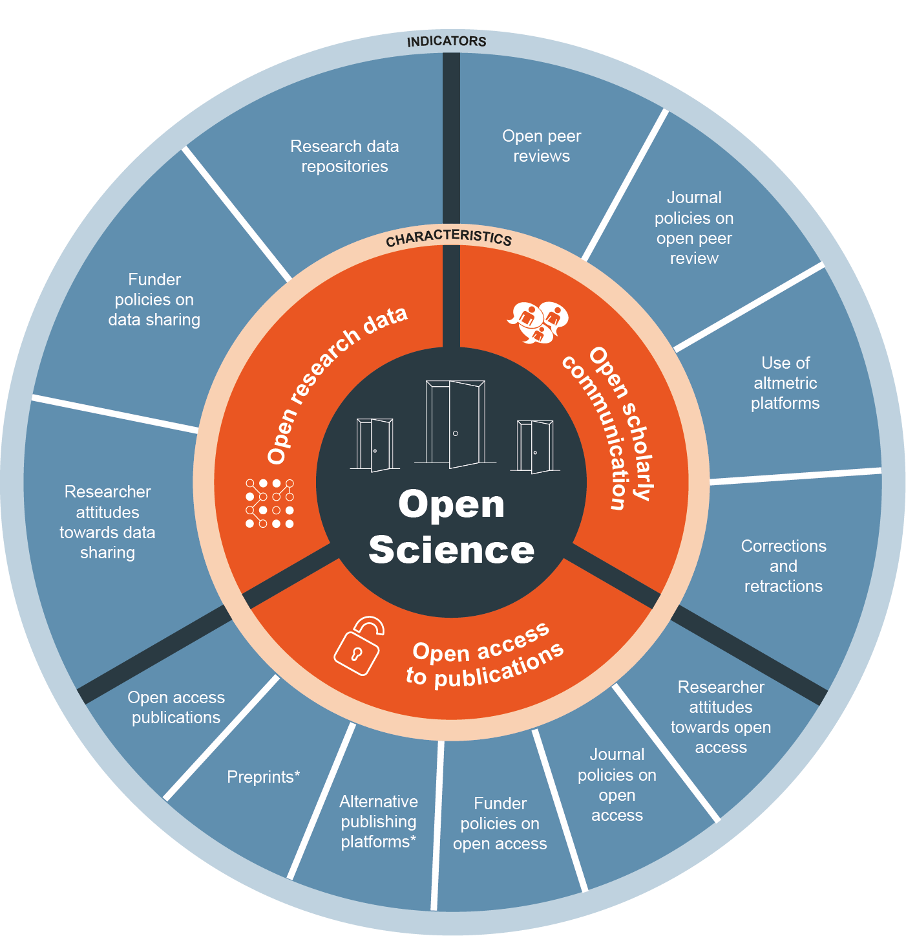
Open Science Monitor
Open Science Monitor
Includes open access to scientific results (publication and data)
However, it is more than that…!
  Researcher Attitude
  Open Peer Review
  Altmetrics
  Correction and Retractions
Source: Open Science Monitor
https://ec.europa.eu/research/openscience/index.cfm?pg=home&section=monitor

Slide 13
2-1. Policy Developments:
Open Access to Research Publications

Slide 14
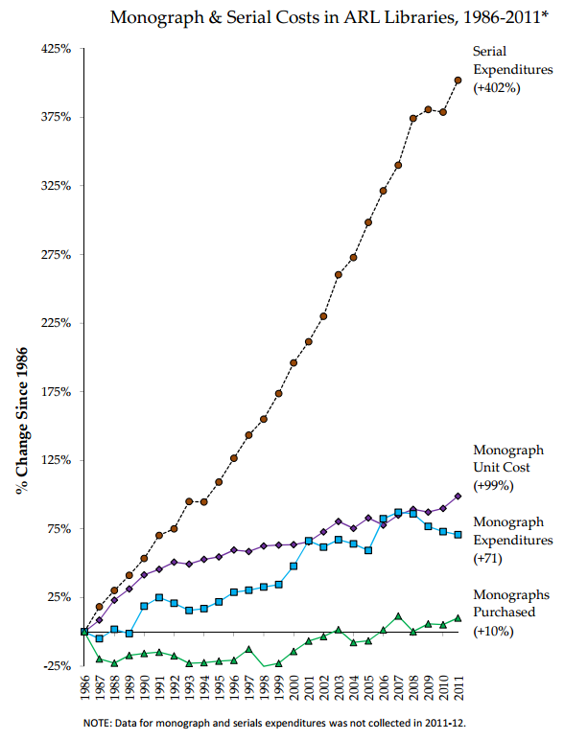
How it started:
“Serials Crisis”
Journal subscription cost rising faster than the inflation speed
  Four times higher in 2011 than 1986
Source: ARL Statistics 2010‐11 Association of Research Libraries, Washington, D.C.
*Includes electronic resources from 1999‐2011.
http://www.arl.org/storage/documents/monograph-serial-costs.pdf

Slide 15
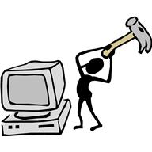
Protest from Academia (1)
Isn’t it unfair
that the publishers are making profit,
and many academics cannot even afford
to read the articles?!
We are writing the articles!
The journal subscription is too expensive!

Slide 16
Protest from Academia (2)
“Subversive Proposal”
  Steve Harnad (1994)
  Called for scholarly articles to be freely available on the Internet, instead of published in print for the sake of royalties.
“An Open Letter to Scientific Publishers”
  34,000 scholars worldwide (2001)
  Called for the establishment of an online public library and pledging to refrain from publishing in traditional non-open-access journals.

Slide 17

Protest from Academia (3)
“Budapest Open Access Initiative (BOAI)”, (2002)
  Provided definition of OA
  Two ways to achieve OA:
    Self-Archiving (green OA)
      Author’s final manuscript or the publisher’s version after a certain embargo period is archived on a website accessible worldwide.
    Open-access Journals (gold OA)
      Subscription fees are omitted instead of a fee charged to the author, usually called the article processing charge (APC).
Source: Budapest Open Access Initiative
http://www.budapestopenaccessinitiative.org/read

Slide 18
Move at Governmental-level
Protest from a medical patient
  “It is unfair that taxpayers do not have access to academic articles and thus cannot study their own medical condition, as the price of academic journals is exorbitant”.
Funding agencies start making OA a mandate for scholarly articles funded publicly
  NIH(US)-2008-”NIH Public Access Policy”
  RCUK(UK)-2013-provides grant to universities for APC

Slide 19
2-2. Policy Developments:
Open Access to Research Data

Slide 20

From Access to Research Publications to Access to Research Data
Publicly-funded
Research
Research Data
Research Publications

Slide 21
Rationale for making
Research Data publicly available
Accountability
  Publicly funded research should be transparent
Economic Efficiency
  Reuse of data leads to new findings without additional investments
Global Challenges Solving and Innovations
  Combining data from multiple discipline leads to solving global challenges
  Industries using data leads to innovations

Slide 22
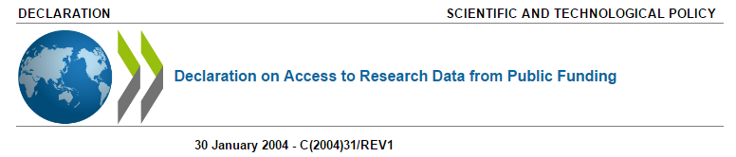
Governments:
  Australia, Austria, Belgium, Canada, China, the Czech Republic, Denmark, Finland, France, Germany, Greece, Hungary, Iceland, Ireland, Israel, Italy, Japan, Korea, Luxembourg, Mexico, the Netherlands, New Zealand, Norway, Poland, Portugal, the Russian Federation, the Slovak Republic, the Republic of South Africa, Spain, Sweden, Switzerland, Turkey, the United Kingdom, and the United States
Commitments:
  Work towards the establishment of access regimes for digital research data from public funding
Principles:
  Openness, Transparency, Legal conformity, Formal responsibility, Professionalism, Protection of intellectual property, Interoperability, Quality and security, Efficiency, Accountability

Slide 23

Data Sharing Policy, NIH (2003-)
In NIH's view, all data should be considered for data sharing. Data should be made as widely and freely available as possible while safeguarding the privacy of participants, and protecting confidential and proprietary data. To facilitate data sharing, investigators submitting a research application requesting $500,000 or more of direct costs in any single year to NIH on or after October 1, 2003 are expected to include a plan for sharing final research data for research purposes, or state why data sharing is not possible.
Data Management Plan (DMP) required!
Source: NIH Data Sharing Policy and Implementation Guidance
https://grants.nih.gov/grants/policy/data_sharing/data_sharing_guidance.htm

Slide 24
Policy Developments in
Research Data Sharing
2003, NIH, Data Sharing Policy
2004, OECD Declaration on Access to Research Data from Public Funding
2007, OECD Principles and Guidelines for Access to Research Data from Public Funding
2007, Biotechnology and Biological Sciences Research Council (BBSRC-UK), Data Sharing Policy
2011, Research Councils UK, Data Sharing Policy
2011, NSF, Data Sharing Policy
2013, OSTP-US, Increasing Access to the Results of Federally Funded Scientific Research
2014-20, Horizon 2020, Open Research Data Pilot

Slide 25


Data Journals and Supplemental Data
Data journals established (2014-)
  Nature: Scientific Data
    Scientific Data is an open-access, online-only journal for descriptions of scientifically valuable datasets.
  Elsevier: Data in Brief
    Data in Brief provides a way for researchers to easily share and reuse each other's datasets by publishing data articles.
Supplemental Data
  Supporting material that cannot be included, and which is not essential for inclusion, in the full text of the manuscript, but would nevertheless benefit the reader.
http://www.nature.com/sdata/ https://www.journals.elsevier.com/data-in-brief

Slide 26

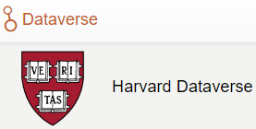

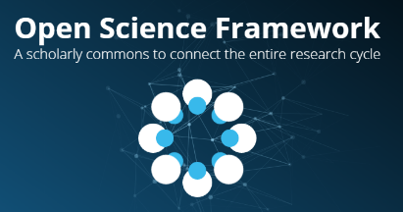


Data Repositories
General
Disciplinary Data Repositories
  Numerous

Slide 27
3-1. Drivers
Data-Intensive Scientific Discovery

Slide 28
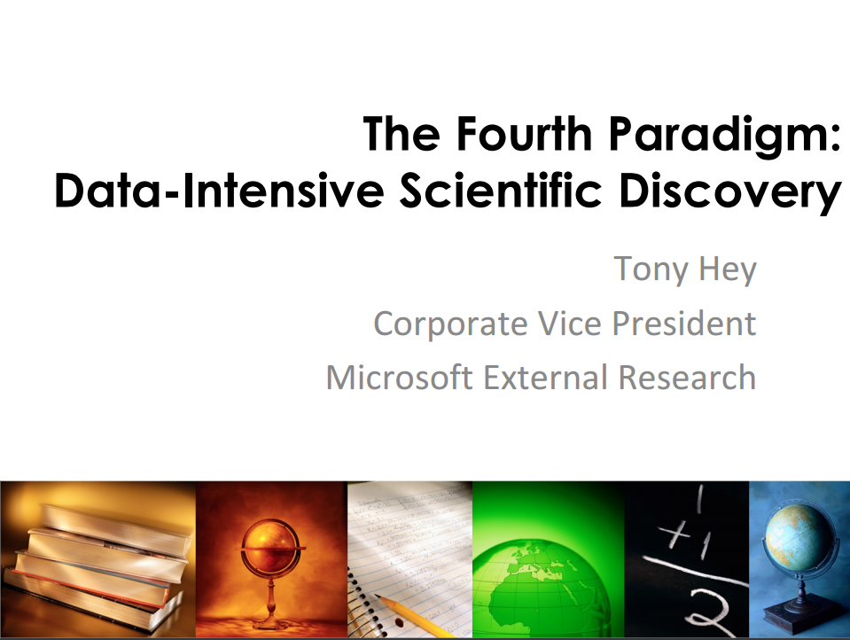

Slide 29
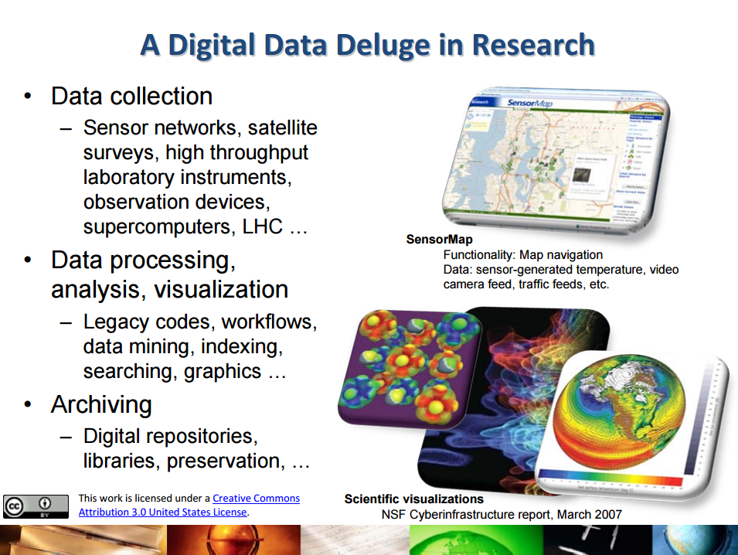

Slide 30
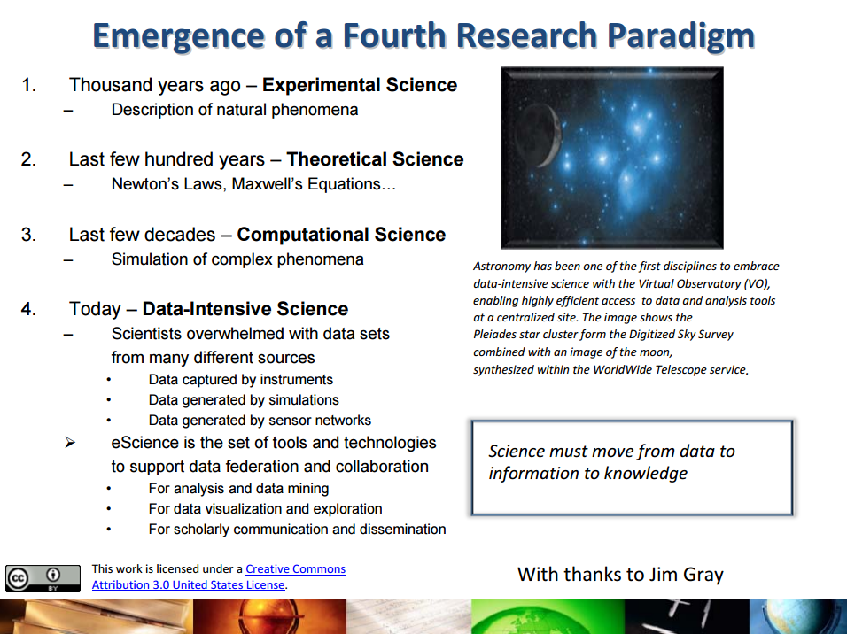

Slide 31
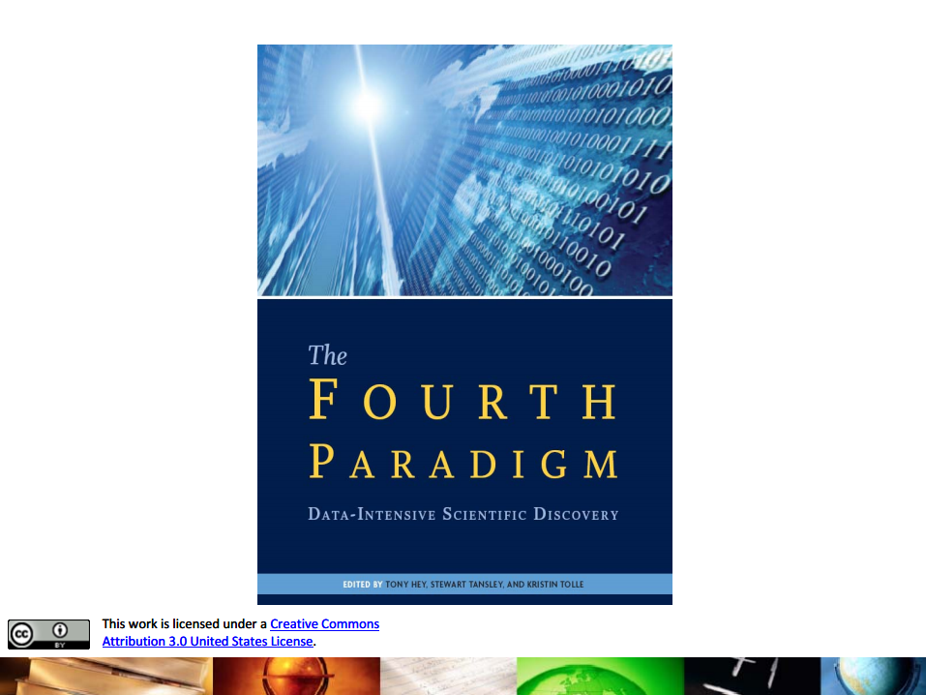

Slide 32
3-2. Drivers
Social Demand

Slide 33
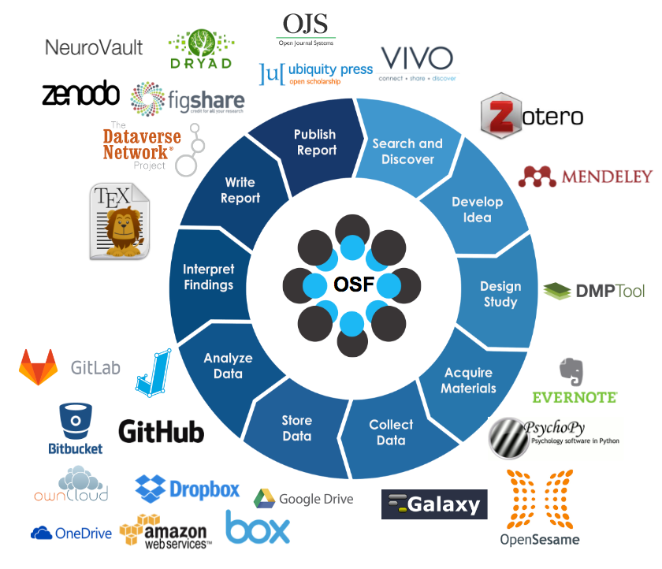
Globalization and Collaboration
More and more researchers working on international collaboration projects
  Need for sharing and storing information
  Need for online collaboration platform
Source: Open Science Framework
https://cos.io/our-products/open-science-framework/

Slide 34
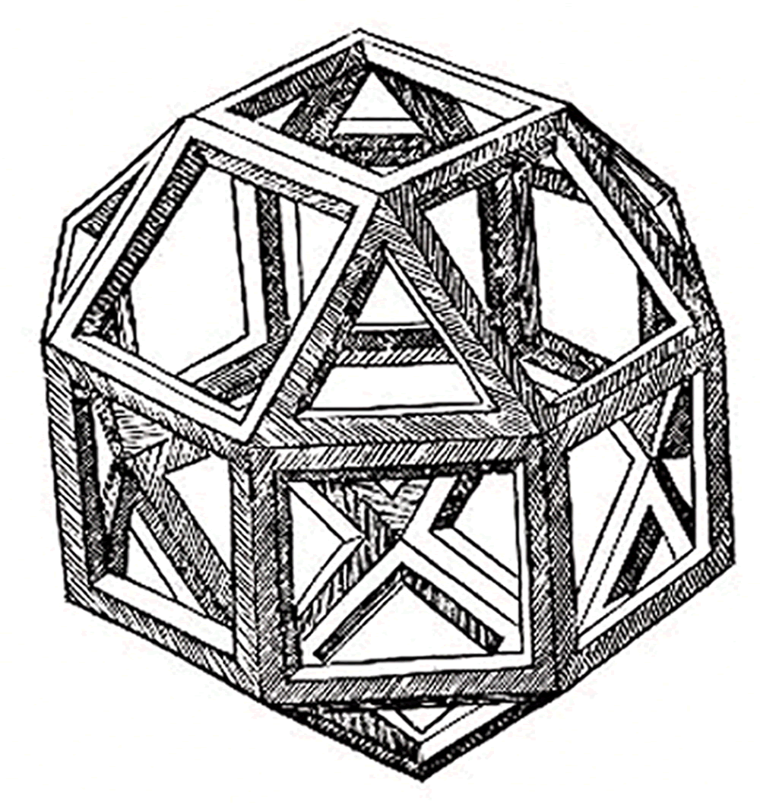
Global Challenge and Innovations
Global challenges and innovations requiring:
  Combining data from various discipline
  Multi-disciplinary collaboration
Data sharing could:
  Enable data combination from various discipline
  Enable research data to be used for industrial purposes and problem solving

Slide 35
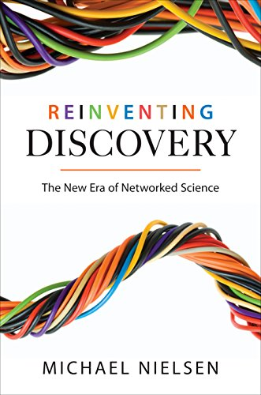
Michael Nielsen
Reinventing Discovery
SPARC honors Michael Nielsen as innovator for bringing Open Science into the mainstream (2012)
Reinventing Discovery tells the exciting story of an unprecedented new era of networked science.
It demonstrated various cases with strong emphasis on citizen science.
https://www.amazon.co.jp/Reinventing-Discovery-New-Networked-Science-ebook/dp/B005OQGZ54
http://sparc.arl.org/news/sparc-honors-michael-nielsen-innovator-bringing-open-science-mainstream

Slide 36


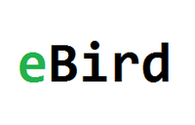
Citizen Science…examples
Galaxy Zoo
  Crowdsourced astronomy project where people classify galaxies
Foldit
  Online puzzle video game about protein folding
eBird
  Online database of bird observations

Slide 37
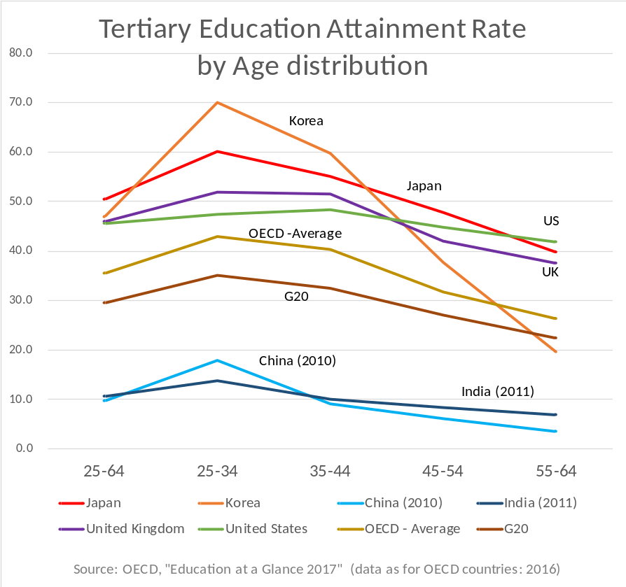
The shrinking gap between society and the academia
Tertiary education attainment rate is rising, especially for younger generation.
Thus, citizens literacy and analytical skills are getting comparable to the academia.
This results in stronger demand for accountability and societal problem-solving.

Slide 38
3-3. Drivers
Call for Research Transparency

Slide 39
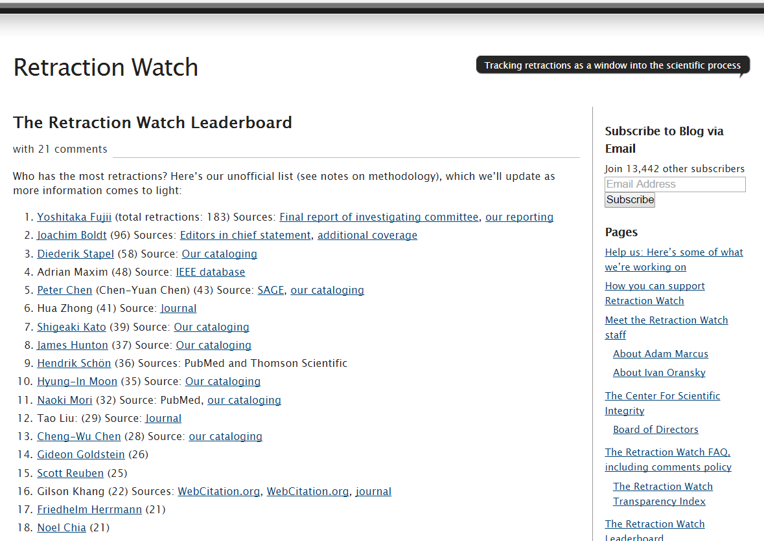
Source: The Retraction Watch Leaderboard
http://retractionwatch.com/the-retraction-watch-leaderboard/ (Accessed 2017/03/19)

Slide 40
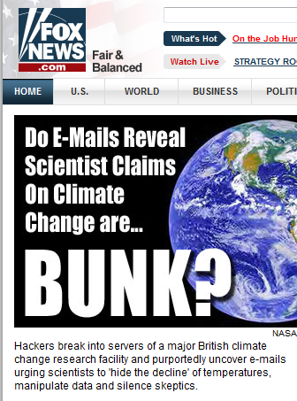
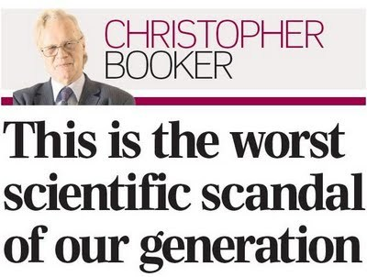

ClimateGate Scandal
Telegraph
http://blog.heartland.org/2011/11/heartland-institute-mentioned-in-climategate-emails-rounds-1-and-2-part-1/
https://wattsupwiththat.com/2009/11/28/telegraphs-booker-on-the-climategate-scandal/
https://thinkprogress.org/climategate-hacked-emails-reveal-global-warming-deniers-are-crazed-conspiracy-theorists-ea8dfeb792b3#.ke1ie5d3v

Slide 41
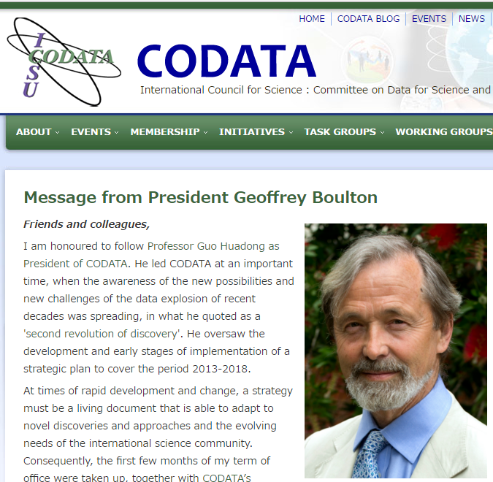
Recent decades have seen an unprecedented explosion in the human capacity to acquire, store and manipulate data and information and to instantaneously communicate them globally, irrespective of location…
…Effective exploitation of Big Data depends fundamentally upon an international culture of 'Open Data' that involves sharing of data and their availability for re-use and re-purposing.
Source: CODATA: Message form President Geoffrey Boulton
http://www.codata.org/message-from-president-geoffrey-boulton

Slide 42

The Royal Society:
Science as an open enterprise (2012)
AREAS FOR ACTION
Scientists need to be more open among themselves and with the public and media
Greater recognition needs to be given to the value of data gathering, analysis and communication
Common standards for sharing information are required to make it widely usable
Publishing data in a reusable form to support findings must be mandatory
More experts in managing and supporting the use of digital data are required
New software tools need to be developed to analyse the growing amount of data being gathered
Source: Royal Society: Final report - Science as an open enterprise
https://royalsociety.org/topics-policy/projects/science-public-enterprise/report/

Slide 43
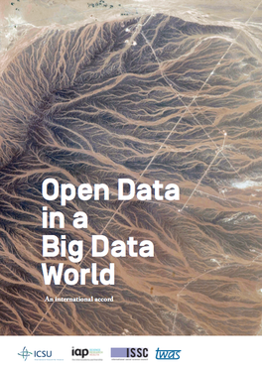
Science International:
Open Data in a Big Data World
The accord identifies the opportunities and challenges of the data revolution as today’s predominant issue for global science policy. It proposes fundamental principles that should be adopted in responding to them. It adds the distinctive voice of the scientific community to those of governments and inter-governmental bodies that have made the case for open data as a fundamental pre-requisite in maintaining the rigour of scientific inquiry and maximising public benefit from the data revolution in both developed and developing countries.
Source: Science International: Open Data in a Big Data World
http://www.icsu.org/science-international/accord

Slide 44

Open Research Data as Good Science Practice
Science is by definition knowledge with evidence, which can be reproduced by others.
  Scientists have to publish their idea openly.
  Scientists must also show the evidence.
In print age, only research articles could be published as evidence.
In digital age, digital research data can also be provided as evidence.
Research data is even better than just articles for the establishment of science!

Slide 45

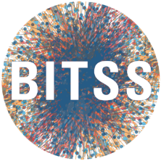

Academics in Action for Research Transparency
Reproducibility Project: Psychology
  Center for Open Science
Berkeley Initiative for Transparency in the Social Sciences
  Center for Effective Global Action (CEGA), UC Berkeley
Peer Reviewers’ Openness Initiative

Slide 46
4. Challenges and
Innovation in Academic Reward System

Slide 47

Challenges of Open Science
Who is going to do the work?
  Incentive for sharing data
  Cost of sharing data
  Training and carrier
What for sensitive data?
  Data with privacy concern or industrial confidentiality can be excluded
I want to write my article before sharing data!

Slide 48


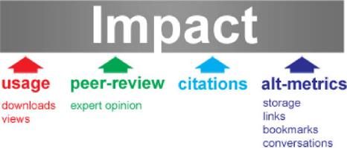



Changing Academic Reward System
Recognizing data
  Data journals
  Data citations
Recognizing social impact
  Altmetrics
http://www.nature.com/sdata/ https://www.journals.elsevier.com/data-in-brief https://www.datacite.org/
http://altmetrics.org/manifesto/ https://impactstory.org/ https://www.altmetric.com/ http://readermeter.org/
Notes:
https://www.jstage.jst.go.jp/article/johokanri/55/9/55_638/_html/-char/ja/

Slide 49
Making data available increases citations
Alter, Pienta, Lyle
  240%, social sciences *
Piwowar, Vision
  9% (microarray data)†
Henneken, Accomazzi
  20% (astronomy) #
# Edwin Henneken, Alberto Accomazzi, (2011) Linking to Data - Effect on Citation Rates in Astronomy. http://arxiv.org/abs/1111.3618
* Amy Pienta, George Alter, Jared Lyle, (2010) The Enduring Value of Social Science Research: The Use and Reuse of Primary Research Data. http://hdl.handle.net/2027.42/78307
† Piwowar H, Vision TJ. (2013) Data reuse & the open data citation advantage. PeerJ PrePrints 1:e1v1 http://dx.doi.org/10.7287/peerj.preprints.1v1
Source: Kevin Ashley, Digital Curation Center, UK
Porto research data conference

Slide 50



Changing Scholarly Communication
…Peer Review System
Open Peer Review
  Reviewer’s comments are open to public with/without the name of reviewer
  Enabling transparent peer review
Post Publication Peer Review
  Peer review done after publishing
  Speeding up publishing, and allowing to count impact in peer review
Cascading Peer Review
  Peer review comments transferred to next submission
  Reducing costs and improving efficiencies in peer review
It takes too long
until published!
Too many
paper to review!
Do the reviewers
really understand
my work?
Notes:
http://www.icsti.org/IMG/pdf/insight_on_peer_review_-_final.pdf
http://www.nature.com/nature/peerreview/debate/

Slide 51
5. The Role of University Libraries
In Open Science

Slide 52

Open Science at
Academic Institution Level
Hold accountability
  Meeting mandates by funding agencies
  Research transparency and reproducibility
Promoting research
  Providing proper research environment
  Accelerating research
Disseminating research of the institution
Linking academia and society

Slide 53

Tangible actions in Open Science at Academic Institutions
Hold accountability for research
  Research office caring for mandates and transparency
  Providing infrastructure for data storage
Disseminating research
  Make research discoverable and reusable
  Provide institutional repositories
Promoting research
  Provide access to scholarly contents, promoting OA
  Promoting new research paradigm, data-intensive science
  Advocating researchers for new research paradigm
  Evaluate research within institution
Linking academia and society
  Matching the needs of society with the seeds of researchers
President

Slide 54
Tangible actions in Open Science at Academic Institutions
Hold accountability for research
  Research office caring for mandates and transparency
  Providing infrastructure for data storage
Disseminating research
  Make research discoverable and reusable
  Provide institutional repositories
Promoting research
  Provide access to scholarly contents, promoting OA
  Promoting new research paradigm, data-intensive science
  Advocating researchers for new research paradigm
  Evaluate research within institution
Linking academia and society
  Matching the needs of society with the seeds of researchers
President
University library related activities highlighted!

Slide 55

Role of University Libraries in promoting Open Science
Providing scholarly contents within institution
  Acquiring and locating scholarly contents (books, e-journals, other)
  Promoting open access
Stewarding scholarship within institution
  Provide storage for active data and long-term preservation
  Provide DMP tool
Disseminating scholarship of institution
  Provide institutional repository for publishing
  Adding proper metadata and curating data
Advocating for good scholarship practices, i.e. Open Science
  Working on Knowledge Graph (linking publication, data, researcher, grant, etc)
  Provide RDM Training

Slide 56
How we classify our tools and services
Data Management Support
Data Management Planning
Active Data Infrastructure
Data Stewardship
Before research
During research
After research

Slide 57
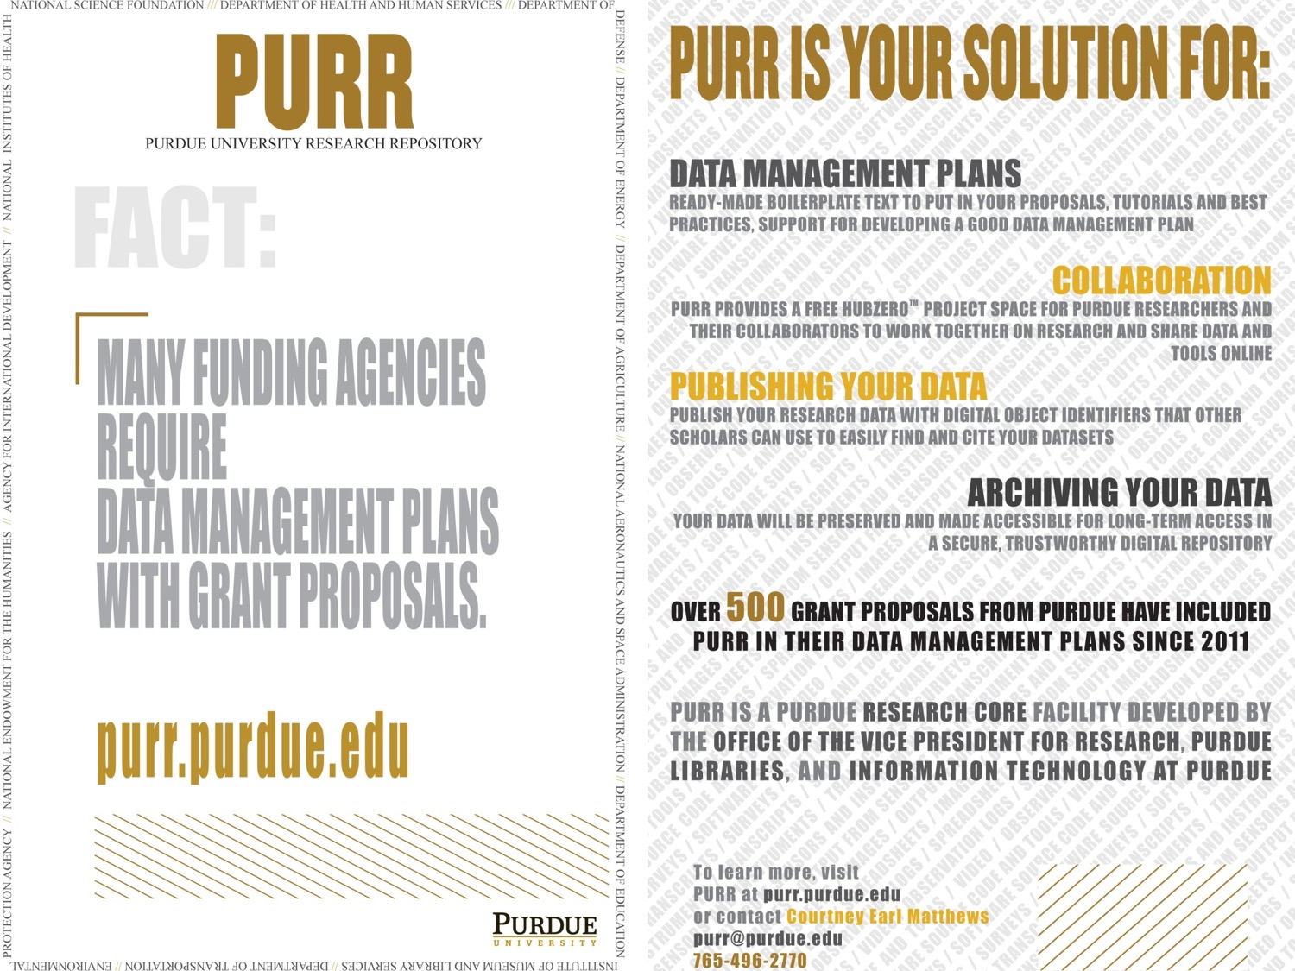
purr postcard and poster
2,542 grant proposals
56

Slide 58
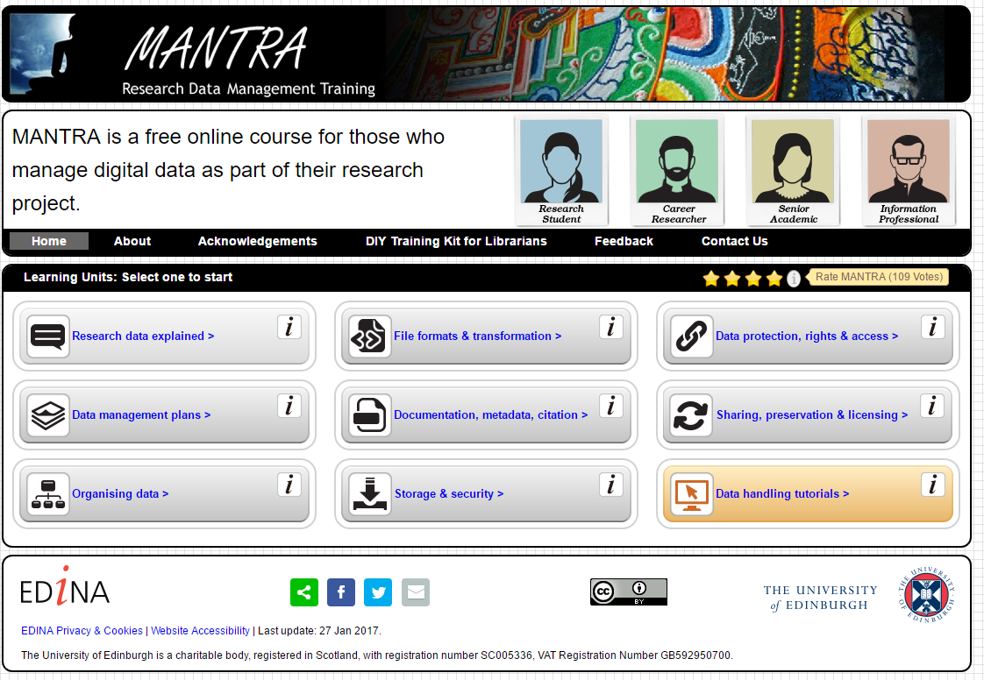
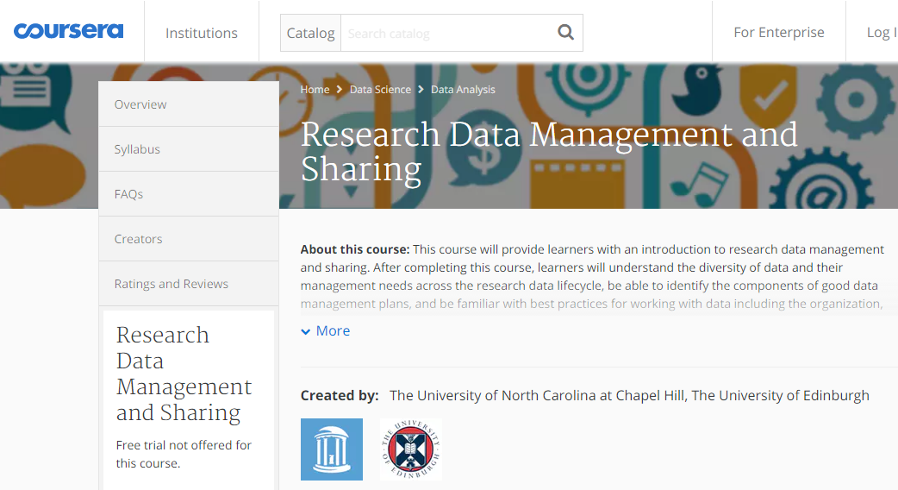
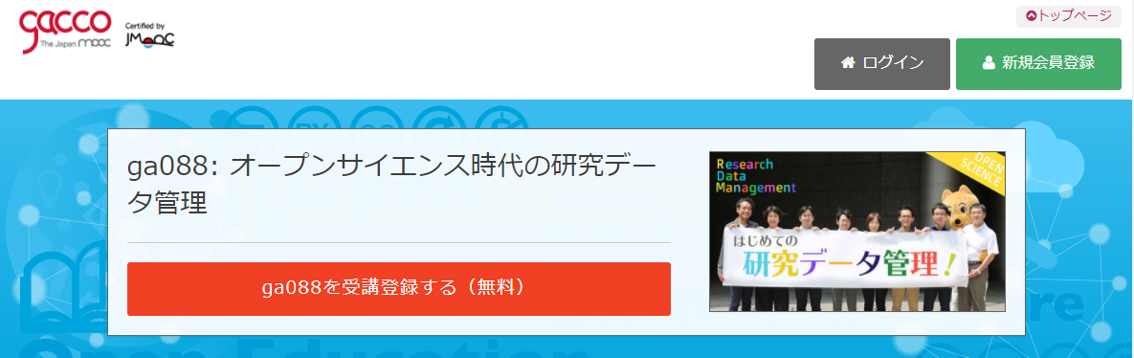
Providing Training for Research Data Management
http://datalib.edina.ac.uk/mantra/
https://www.coursera.org/learn/data-management
https://lms.gacco.org/courses/course-v1:gacco+ga088+2017_11/about

Slide 59

University Libraries in Open Science Era
Expanding the scope of scholarly contents
  Books, journals, gray-literature, research data
Develop new services for new contents
  DMP tools, RDM training
  Data curation, facilitating reuse of scholarship
  Building knowledge graph
Advocating of good scholarship practices in the Open Science era!
  Promoting open access and RDM
  Disseminating and promoting reuse of scholarship
  Caring for research transparency and reproducibility
  Advocating for new research paradigm
As the steward of scholarship of the institution,
be the change agent for new research paradigm!

