Slide 1
Best Practices in Developing and
Enhancing Institutional Repositories
Kazu YAMAJI
National Institute of Informatics
LIBRARIANS ASSOCIATION OF MALAYSIA
WORKSHOP ON NEXT GENERATION REPOSITORIES
12TH – 13TH APRIL 2018
HOTEL SERI MALAYSIA, KANGAR, PERLIS

Slide 2
National Research and Education Network
SINET is a Japanese academic backbone network for more than 800 universities and research institutions, and for about 3 million users.
  SINET covers 100% of national, 78% of municipal, and 55% of private universities.
 | National Universities | Municipal Universities | Private Universities | Junior Colleges | Colleges of Technology | Inter-Univ. Research Institutes | Labs and Others | Total
Number of Organizations | 86 (100%) | 71 (78%) | 348 (55%) | 62 (18%) | 55 (97%) | 16 (100%) | 179 | 817
Sapporo
(As of March 2015)
: SINET node
: Domestic line (100Gbps or more)
To Europe
: International line (100Gbps)
: International line (10Gbps)
Fukuoka
Osaka
Tokyo
To US
To Asia

Slide 3








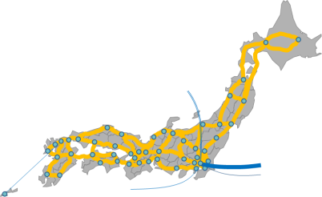
SINET5
21st Century Academic Information Infrastructure
for Advancing Open Science
Collaboration and Promotion in Research and Education
Resource
Federation
Promotion of academic information circulation and open access
Collaborative promotion of institutional repository expansion
Collaborative enhancement of authentication between universities
GakuNin
Federation
Cloud
Security
Flow Analysis
Dramatic cost reduction and enhancement of research and education environment by tailored cloud services
Network flow analysis and dynamic control
Raise of security level for SINET users
GakuNin-Cloud
Direct Connection
VPN
Network
Nationwide 100-Gbps backbone network and scalable network expansion
High-speed direct international lines to USA, Europe, and Asia
Introduction of new technologies such as SDN in response to user needs

Slide 4





Scholarly Information Infrastructure
Journal articles
Journal articles
Catalog information
Research Information
CiNii
Articles
CiNii
Books
KAKEN
JAIRO
Metadata and links of Japanese journal articles
19 M records
Metadata and links of Japanese institutional repositories
2.5 M records
Catalog of materials held by universities
Bibliographic info 11 M records
Holding information 137 M records
Project reports of MEXT
supported scientific researches
820 K record
Compilation
NACSIS-CAT
Shared
Repositories
Compilation
Integration
Digitization
JSPS
MEXT
J-Stage
(JST)
NDL
学協会
学協会
I
Academic
Societies
Institutional
repository
Univ.
Library
More than 1,300 libraries
Linkage to other DB services
More than 800
institutions
Universities and Research Institutions
Note: The record numbers are as of March 2017

Slide 5
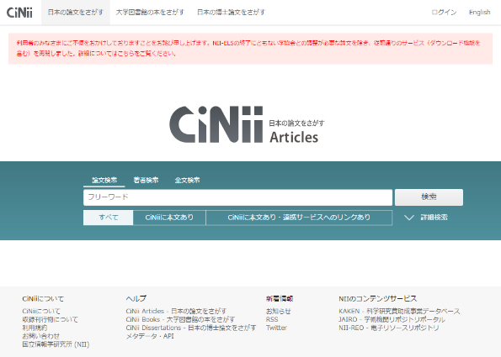
Discovery Service CiNii
Articles and Searches
2009.4
Drastic UI Renewal
19,730
12,000
2007.4
Indexed by Google
2016
Monthly ave.
■full text DL
4.52M
■detail view
10.9M
■search
4.93M

Slide 6
Scholarly Information Infrastructure
Journal articles
Journal articles
Catalog information
Research Information
CiNii
Articles
CiNii
Books
KAKEN
JAIRO
Metadata and links of Japanese journal articles
19 M records
Metadata and links of Japanese institutional repositories
2.5 M records
Catalog of materials held by universities
Bibliographic info 11 M records
Holding information 137 M records
Project reports of MEXT
supported scientific researches
820 K record
Compilation
NACSIS-CAT
Shared
Repositories
Compilation
Integration
Digitization
JSPS
MEXT
J-Stage
(JST)
NDL
学協会
学協会
I
Academic
Societies
Institutional
repository
Univ.
Library
More than 1,300 libraries
Linkage to other DB services
More than 600
institutions
Universities and Research Institutions
Note: The record numbers are as of March 2017

Slide 7

NII-funded Programs
NII-IRP (Institutional Repositories Program) http://www.nii.ac.jp/irp/en/
  Phase 1 : FY2005-2007
  Phase 2 : FY2008-2009
  Phase 3 : FY2010-2012
  Three categories of funding
    Area 1: Support for developing IRs and content creation
    Area 2: Research and development
    Area 3: Support for community activities
 | Phase 1 |  |  | Phase 2 |  | Phase 3
 | 2005 | 2006 | 2007 | 2008 | 2009 | 2010 | 2011 | 2012
Area 1 (Institutions) | 19 | 57 | 70 | 68 | 74 | 24 | 31 | 34
Area 2 (Projects) | - | 22 | 14 | 21 | 21 | 8 | 8 | 7
Area 3 (Projects) | - | - | - | - | - | 5 | 4 | 4

Slide 8
Expansion of IRs until 2011

Slide 9
Implementation Rate of IRs in JAPAN
  Almost all national universities have their own IRs, while the implementation rate of
  other public/private universities hovers at
  20-30%
  in 2012

Slide 10

Matters Surrounding IRs in Japan
Ministry of education and research in Japan mandated the digitalization of doctoral dissertations and their dissemination over the network.
  In 2013 when the above was stated, there still were about 200 universities which does not have IRs.
There are more than 700 HEs in Japan
The universities which have already owned their IRs were also struggling with how to update and maintain the system in the sustainable manner.

Slide 11
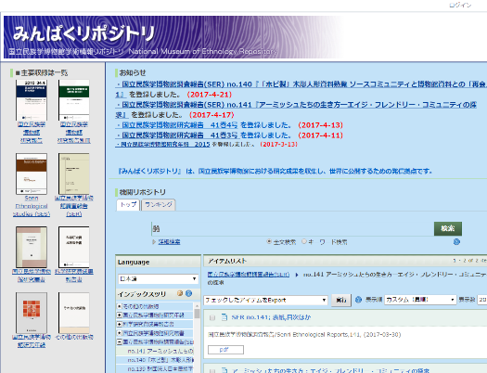
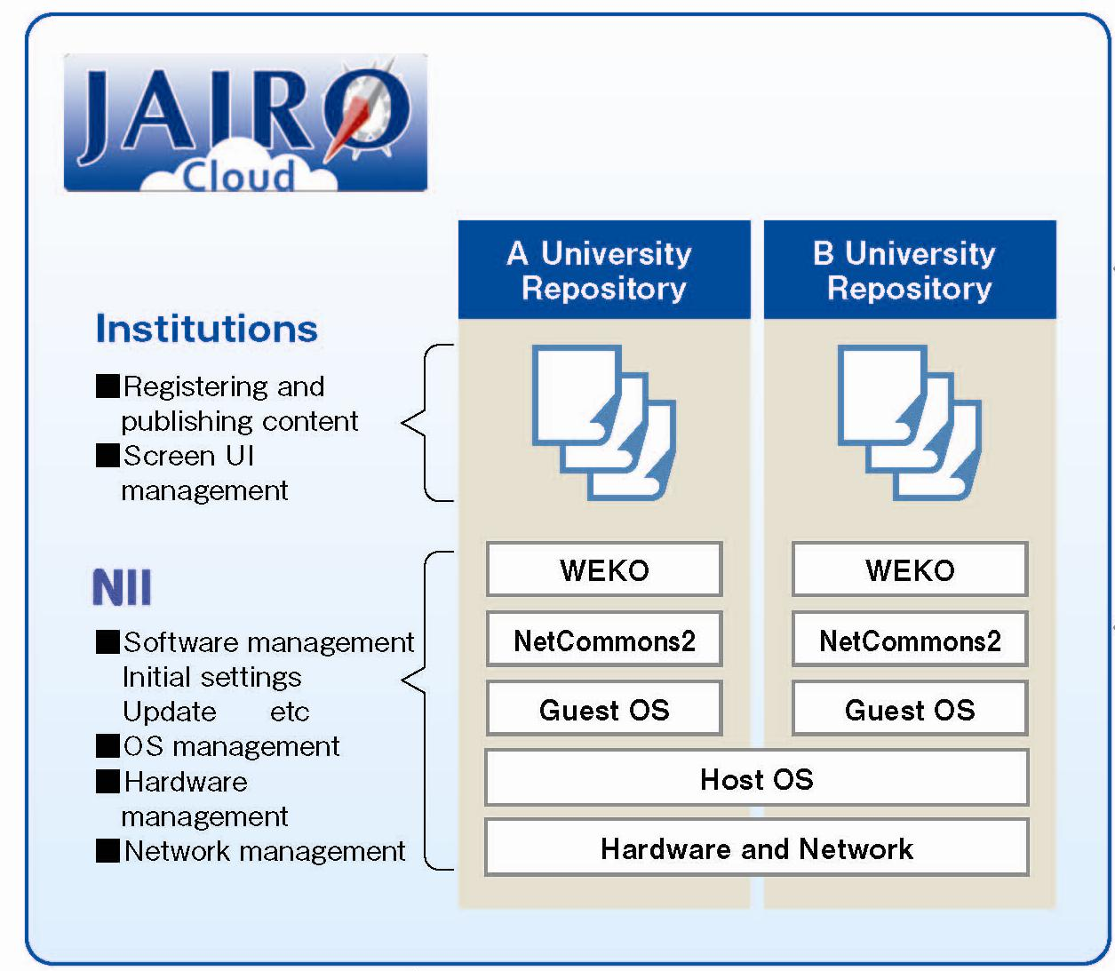
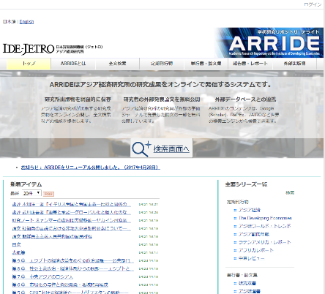
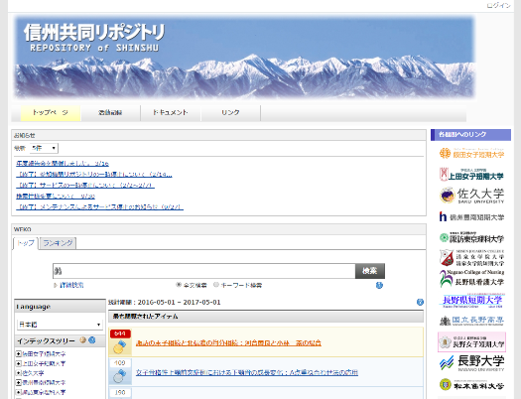
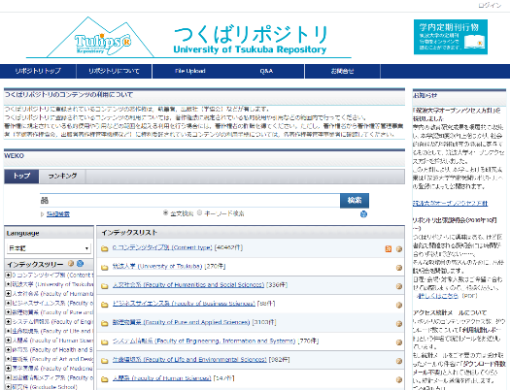
JAIRO Cloud
Background
  Limited resources and less technical knowledge hamper implementation of IR especially in small universities.
  JAIRO Cloud provides a shared instance of IR system on the virtual server hosted by NII since April 2012.
Service Architecture

Slide 12
Number of Institutional Repositories in Japan
811 IRs
784 IRs
■ by JAIRO Cloud: Pilot Operation
■ by JAIRO Cloud: Production Operation
■ by University On-premise System

Slide 13





Portal services of Japanese IRs
NII harvests almost all Japanese IRs
- JAIRO is a “gyroscope” of
IR content
- Use it to search all
IRs in Japan at once!
OAI-PMH
IRDB Content Analysis shows
how contents are growing and
gives detailed information on each IR.
New
Schema
“JPCOAR”
CiNii is the largest database of
academic journal articles in Japan.
Metadata on journal articles
and departmental bulletins goes to CiNii and is linked to the full texts in the IRs.
junii2
junii2 is a “Dublin Core” application profile for
institutional repository with an OpenURL
compliant schema.
It has been adopted by almost all IRs in Japan.
http://www.nii.ac.jp/irp/en/archive/pdf/junii2_en_20090213.pdf

Slide 14
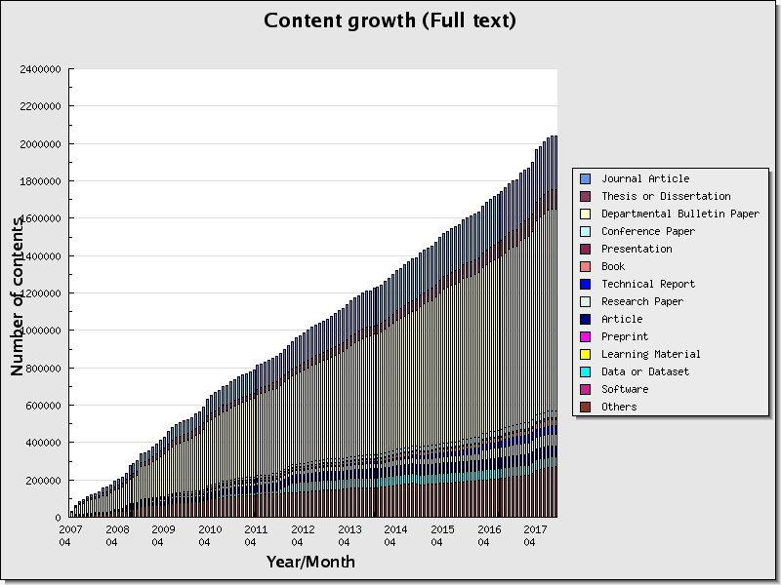
Contents Type stored in Japanese IRs

Slide 15
Contents Type stored in Japanese IRs
Journal Article | 288,709 (14.1%)
Thesis or Dissertation | 103,478 (5.1%)
Departmental Bulletin Paper | 1,080,358 (52.9%)
Conference Paper | 35,303 (1.7%)
Presentation | 12,251 (0.6%)
Book | 32,839 (1.6%)
Technical Report | 43,313 (2.1%)
Research Paper | 63,771 (3.1%)
Article | 54,470 (2.7%)
Preprint | 624 (0.0%)
Learning Material | 4,578 (0.2%)
Data or Dataset | 53,736 (2.6%)
Software | 46 (0.0%)
Others | 268,744 (13.2%)
Total | 2,042,220
NII Institutional Repositories DataBase Contents Analysis
http://irdb.nii.ac.jp/analysis/index_e.php

Slide 16
Repository Community
Digital Repository Federation, since 2006
JAIRO Cloud Community, since 2012
Institutional Repository Promotion Committee, since 2013
Japan Consortium for Open Access Repository (JPCOAR)
  Working Group
    Training WG
    JAIRO Cloud Operation WG
    Promotion WG
  Task Force
    Next Generation Metadata Schema TF
    Research Data TF
    Open Access Policy and Tracking TF
    Repository Evaluation TF
    ORCID TF
From 2016

Slide 17
From Open Access
to Open Science

Slide 18
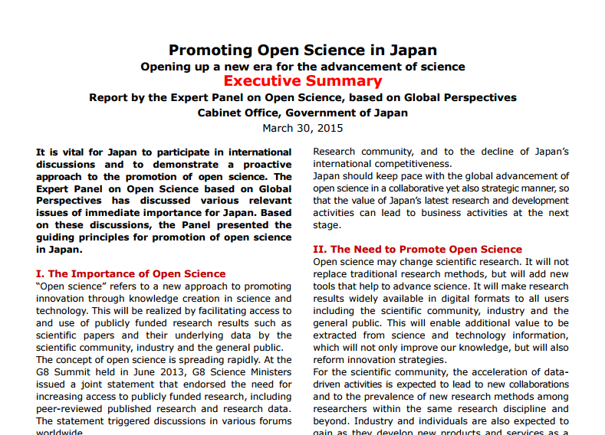
Open Science Report from
Japanese Cabinet Office (2015)
http://www8.cao.go.jp/cstp/sonota/openscience/150330_openscience_summary_en.pdf

Slide 19
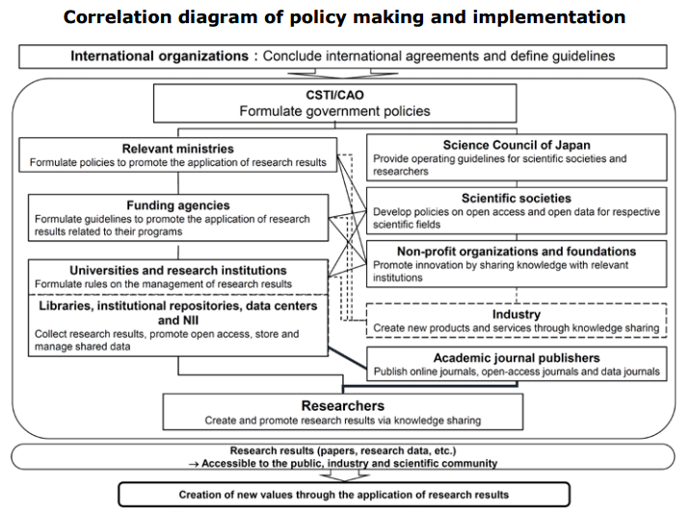
Framework of the Open Science in Japan
http://www8.cao.go.jp/cstp/sonota/openscience/150330_openscience_summary_en.pdf

Slide 20
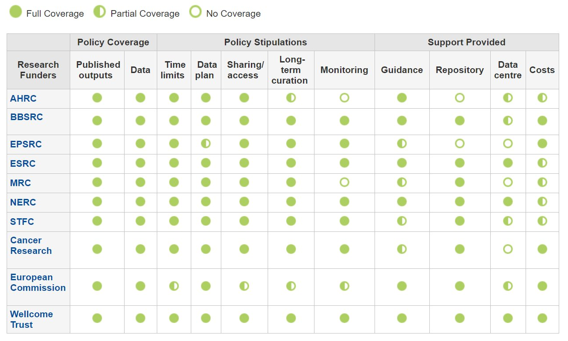
Example of Funders’ Policy in UK
Funders’ data policies summarized by Data Curation Center
http://www.dcc.ac.uk/resources/policy-and-legal/overview-funders-data-policies
Data plan: requirement to consider data creation, management or sharing in the grant application
Some of Japanese Funders such as AMED and JST also started to request DMP

Slide 21
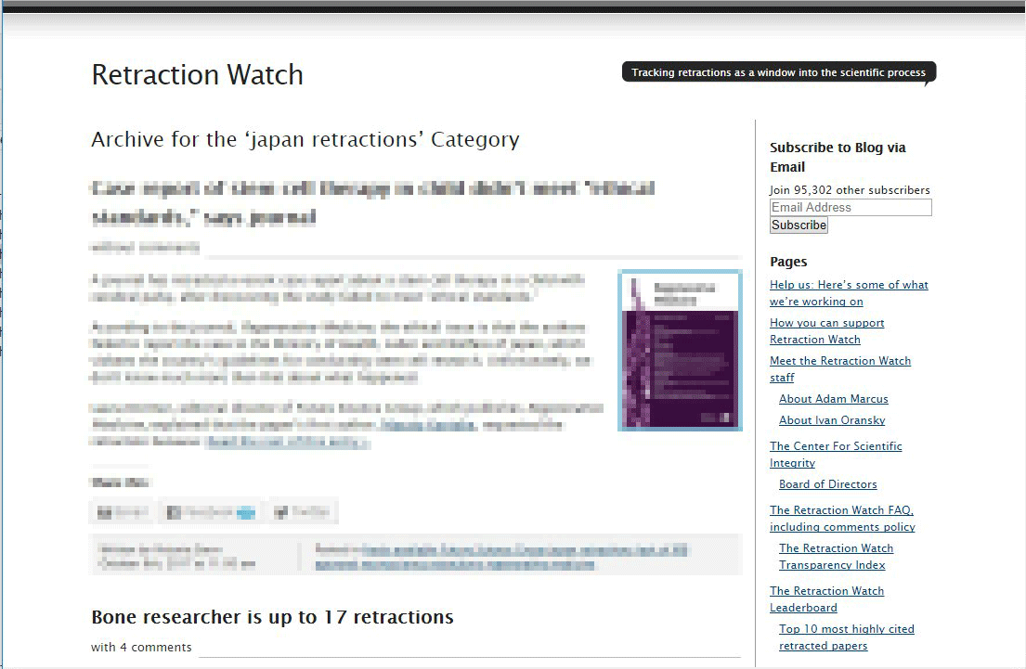
Pressure on Data
http://retractionwatch.com/category/by-country/japan-retractions/

Slide 22
Intention and Approach
WHY (Open Science)
  Innovation, Research Acceleration, Interdisciplinary Collaboration
  Transparency, Research Integrity and reproducibility
HOW
WHO
WHAT

Slide 23
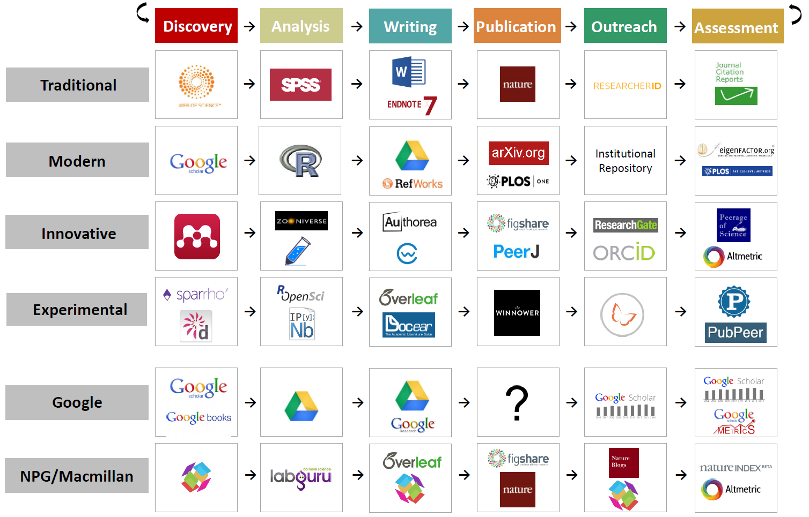
Existing Scholarly Communication Tools
BY: Jeroen Bosman, http://dx.doi.org/10.6084/m9.figshare.1286826

Slide 24




Things to Avoid by Our Effort
Invented Cool Tools by Small Company
User Explosion
Require Big Investment
Under the Umbrella of Big Company
Monopoly

Slide 25
Digital Divide resulted from Monopoly Phenomena
Number of Institutional Contract with Major Publishers
Data provided by Japan Alliance of University Library Consortia for E-Resources（JUSTICE）

Slide 26

（2017.3.24）

Slide 27

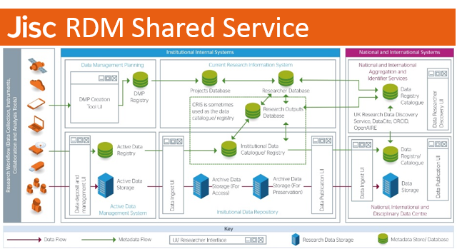

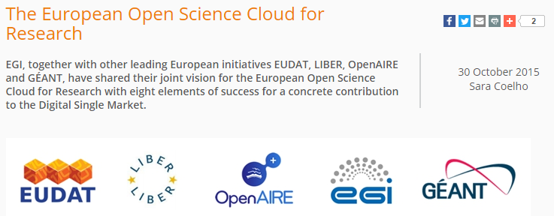


National Research Infrastructure for OS

Slide 28
Intention and Approach
WHY (Open Science)
  Innovation, Research Acceleration, Interdisciplinary Collaboration
  Transparency, Research Integrity and reproducibility
HOW (Environment)
  Preserve Control within Academic Community
    Maximize Open Source Software
    Maximize User Community for System Development
WHO
WHAT

Slide 29
Long Tail Feature in Japanese Universities
 | University | Number of Students
1 | Nihon University | 67,933
2 | Waseda University | 41,965
...
22 | Osaka University | 15,358
…
25 | The University of Tokyo | 14,002
Number of Students in FY2017
Universities Sorted by Size
JAIRO Cloud is a good example for supporting long-tail

Slide 30
Intention and Approach
WHY (Open Science)
  Innovation, Research Acceleration, Interdisciplinary Collaboration
  Transparency, Research Integrity and reproducibility
HOW (Environment)
  Preserve Control within Academic Community
    Maximize Open Source Software
    Maximize User Community for System Development
WHO (Stakeholder)
  as Longtail (need to define a certain level) as Possible
WHAT

Slide 31
NII Scholarly Information Services
Journal articles
Journal articles
Catalog information
Research Information
CiNii
Articles
CiNii
Books
KAKEN
JAIRO
Metadata and links of Japanese journal articles
19 M records
Metadata and links of Japanese institutional repositories
2.5 M records
Catalog of materials held by universities
Bibliographic info 11 M records
Holding information 137 M records
Project reports of MEXT
supported scientific researches
820 K record
Compilation
NACSIS-CAT
Shared
Repositories
Compilation
Integration
Digitization
JSPS
MEXT
J-Stage
(JST)
NDL
学協会
学協会
I
Academic
Societies
Institutional
repository
Univ.
Library
More than 1,300 libraries
Linkage to other DB services
More than 600
institutions
Universities and Research Institutions
Note: The record numbers are as of March 2017

Slide 32

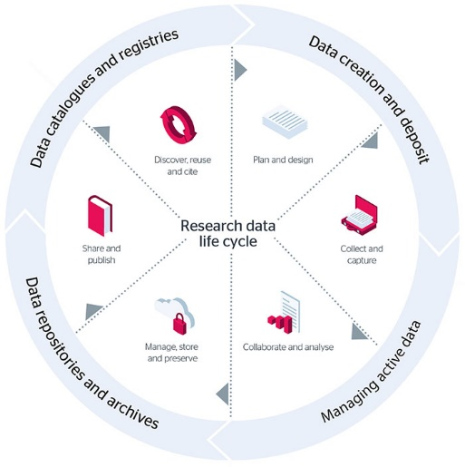

Current NII Services and Research Workflow
Open
Closed
Not yet supported
Discovery Service
Project Start (Application)
Member Management
Initial Setting
Aggregation
Experiment
Data Acquisition
Publication Platform
Institutional or
Domain
Repository
Data Management
Data Analysis
Paper writing
Deposit with Supplemental Data

Slide 33
Intention and Approach
WHY (Open Science)
  Innovation, Research Acceleration, Interdisciplinary Collaboration
  Transparency, Research Integrity and reproducibility
HOW (Environment)
  Preserve Control within Academic Community
    Maximize Open Source Software
    Maximize User Community for System Development
WHO (Stakeholder)
  as Longtail (need to define a certain level) as Possible
WHAT (Infrastructure)
  Support Research Workflow throughout closed Environment

Slide 34


Research Data Infrastructure for Open Science
Discovery Platform
DOI
International
Metadata
Aggregator
● Linking Func between Article and Data
● Researcher and Research Project
Identification and Management Func
● Data Exchange with International
Discovery Service
Metadata Management
Subject
Repository
Discovery Service
Metadata Aggregation
User Flow
Data Flow
Re-use
Search/Find
Data User
Journal Article
Supplemental
Data
Research Data Mng
User Interface
Access Control
Metadata Mng
Data Depositor
Institutional Research Data Mng
Research Data Management System
Exp/Store
Archive
Research Data Repository
RDM Platform
Exp Data
Article
Publication Platform
Private
Shared
Public
by
● High Speed Access using SINET5
● Data Sharing Func using
Virtual NW and ID Federation
● Effective Data Storage Switcher
Hot
Storage
Hot
Storage
Hot
Storage
● Data oriented Self-Archiving Func
● Versioning and auto-Packaging Func
● User Dependent Personal Data
Pseudonym Func
Cold
Storage
Cold
Storage
Cold
Storage
Storage Area for Long-term Preservation

Slide 35
Challenge to Develop Research Data Infrastructure
Open Access
  Journal Article, Article Search
    Well defined Metadata Format and Use-Case
    Add useful functionalities
Open Science
  Research Data in addition to OA materials
    Variety : Different types of Format and Use-Case
    Critical : Daily Use (Especially RDM Service)
Flexibility Expansibility
Confidentiality
Integrity
Availability
System Specification
get Difficult to Define
People get Angry
once Stopped
System Development and Operation
Micro Service-zation of Application Architecture
Dev/Ops through CI/CD
(Completely Different Approach from our Previous Services)

Slide 36
Comparison of Existing Repository System
Repository | License | Programming Language | Framework | CMS | DB | Metadata Store | Full-text search | O/R mapping | Message oriented middle-ware
DSpace | BSD 3-Clause | Java | Cocoon |  | PostgreSQL | PostgreSQL | Solr | Hibernate
EPrints | GPL 3 | Perl |  |  | MySQL | MySQL
Fedora | Apache 2.0 | Java | Spring |  | ModeShape | ModeShape
HUBzero | GPL 2 | PHP | Joomla! | ○ | MySQL | MySQL
Invenio | GPL 2 | Python | Flask |  | PostgreSQL | PostgreSQL | Elasticsearch | SQLAlchemy | Celery/RabbitMQ
Hyrax/ Hyku | Apache 2.0 | Ruby | Samvera |  | MySQL | Fedora | Solr | ActiveFedora | Sidekiq/Redis
Samvera | Apache 2.0 | Ruby | Ruby on Rails |  | - | Fedora | Solr | ActiveRecord
Islandora | GPL 3 | PHP | Drupal | ○ | MySQL | Fedora | Solr | ActiveFedora
dataverse | Apache 2.0 | Java |  |  | PostgreSQL | PostgreSQL | Solr
WEKO2 | BSD-2-Clause | PHP | NetCommons2 | ○ | MariaDB | MariaDB | Mroonga
Research Data Repository
Flexibility & Extensibility
Micro Service Architecture

Slide 37


Architecture of Publication Platform
Institutional Repository
Article, Gray Literature
Digital Archive
Research Data
Educational Materials
Etc.
Domain Repository
Article, Technical Report
Research Data, Supplemental Data
Add-Value Service
(Statistics Information, CRIS Linkage …)
Publication Platform
WEB UI
WEB API
(REST API, SWORD, SPARQL)
External System
（CRIS, Portal Site …)
Custom UI
Repository System Core Function
Task Management
DB
Ext
Func
Stat
Anal
Fulltext
Search
Message
Process
Image
Process
Ext API
Work
flow
GakuNin RDM
API
Microservices
External
Storage
ORCID
Mendeley

Slide 38
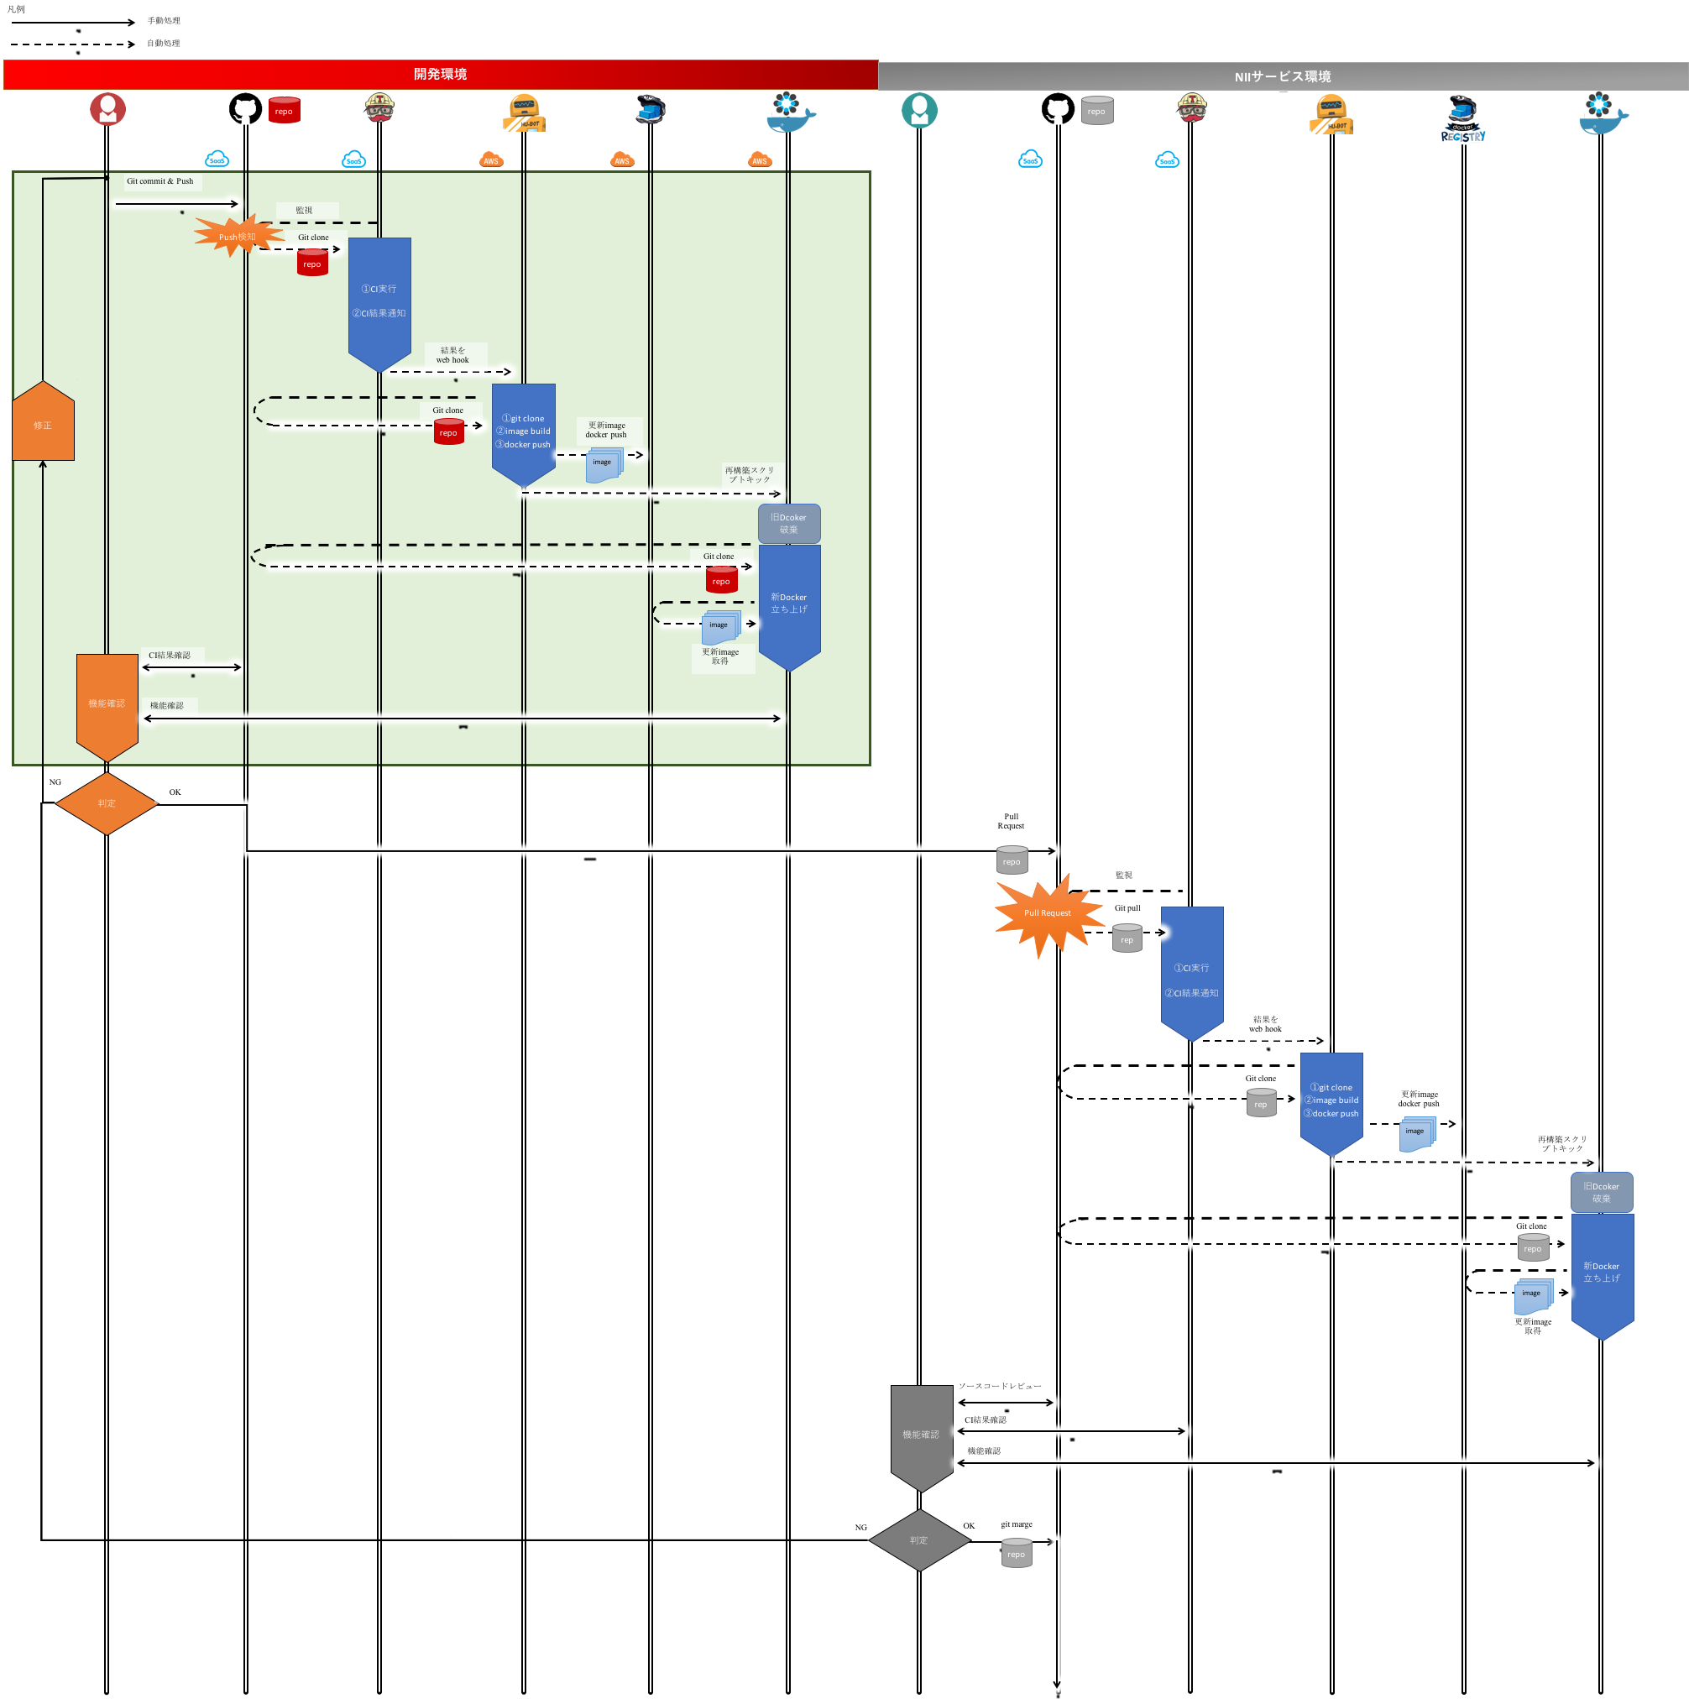
Dev/Ops Flow of RDM Platform
Developer
GitHuB
TravisCI
HU-BOT
Docker
Dist
Staging
Operator
GitHuB
TravisCI
HU-BOT
Docker
Dist
Product
Service
Automate all process from Test to Deployment
Continuous System Update in Short Term

Slide 39












Mission of Discovery Platform
Discovery Platform
Metadata Search for Research Data stored in Publication Platforms and Other External DBs
  Title, Creator, Date, Format…
Discovery based on Linked Data around Research Activity
  Article, Research Data, Researcher, Project, Fund…
Research Project
Researcher
Conventional Research Output
Project ID
Researcher ID, ORCID…
DOI, Handle, URI, ISBN, ISSN...
Funding Agency
Research Activity
Crossref Funder, GRID, ISNI...
Research Data
DOI, URI...
Research Institution
Institutional ID, GRID, ISNI...

Slide 40
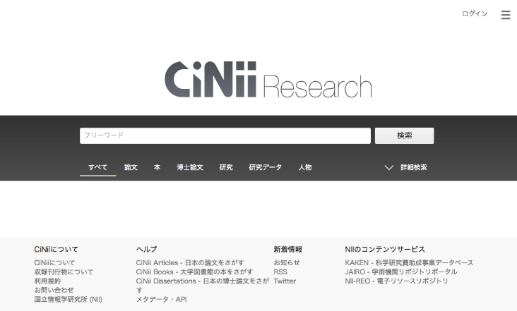
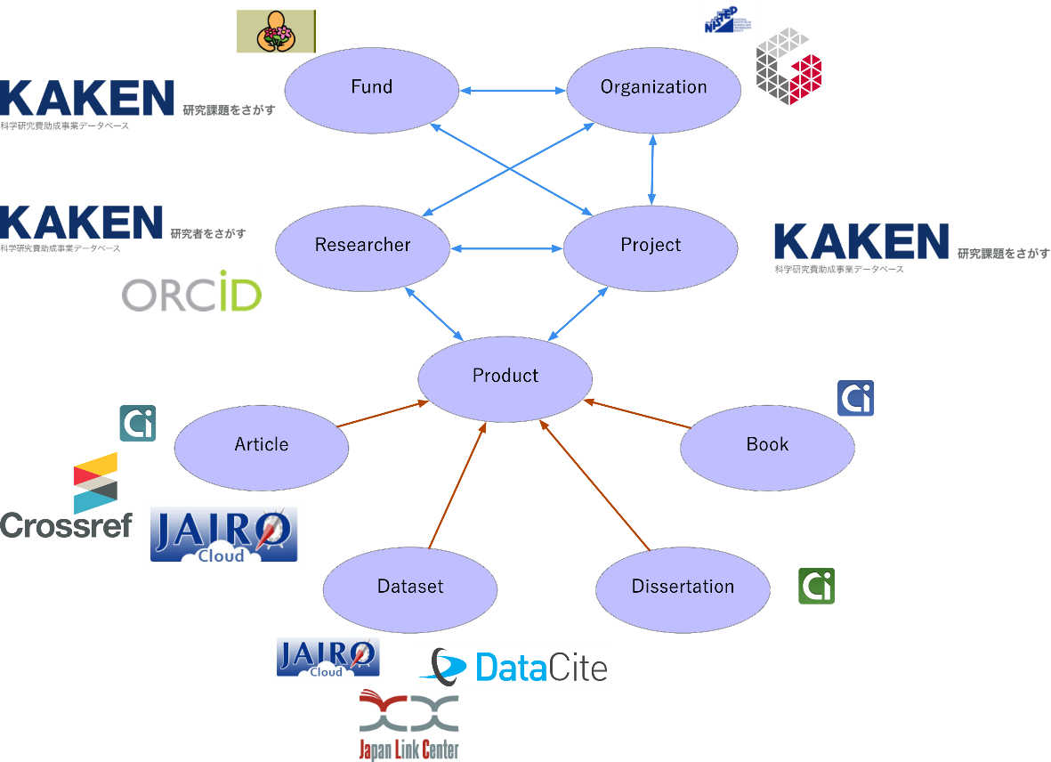
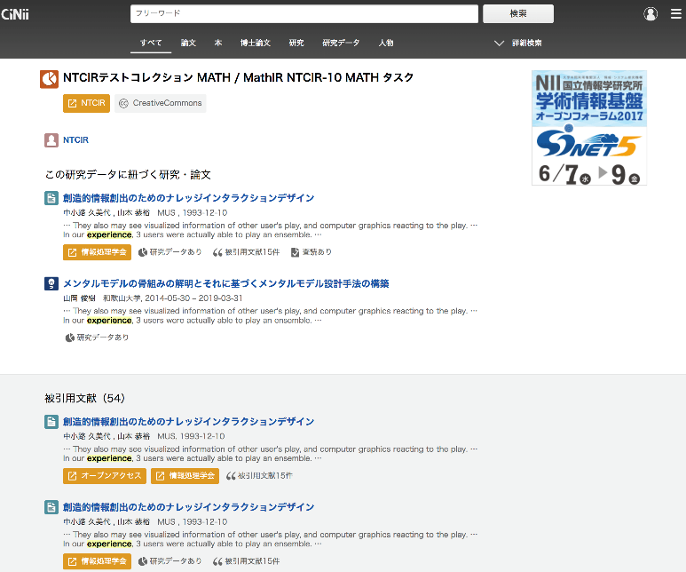
Discovery
Platform
NII Knowledge Graph
  Aggregate from various DBs
  Define Entity Links
User Interface
  Support Discovery Experience for Research Data via Article and Project

Slide 41
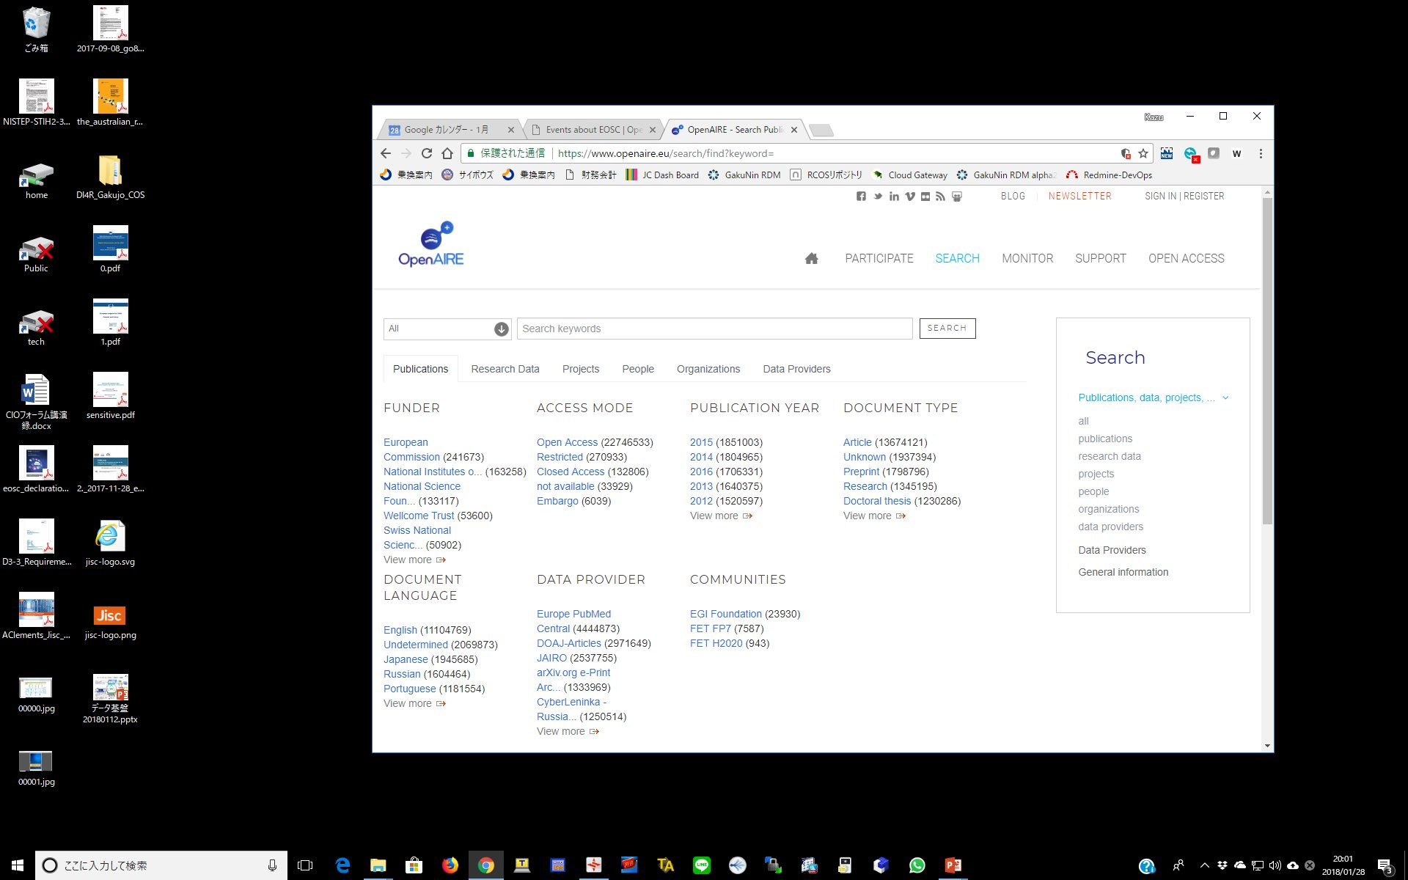
Future Plan on Discovery Platform
Discovery
Platform
FY2017 : Data Aggregation, API Specification, Initial UI Development
FY2018 : Knowledge Graph Development, UI Improvement …
Deployment
  2019 Pilot Operation
  2020 Production Operation
Integration
  Domestic Domain DBs
  Service Level Integration
    API, Backend Data
Collaboration
  OpenAIRE
  Data Level Collaboration
    Knowledge Graph Exchange

Slide 42
Mission of Publication Platform
Publication
Platform
Aa a Article Repository
  Institutional and Funding Agency’s Mandate
    Support Different Type of Workflow in each Institution
    Reduce Workload for Registration and Publication
  JAIRO Cloud Service
    Be Ready to Accept All of Japanese Universities and Research Institutions
As a Data Repository
  Support Stressless Deposit Evidence Data with Article
  Support Respective Demand in Different Use case
  Support Scalable Operation
How to Realize IT?

Slide 43

Publication
Platform
Current WEKO2
  Gradually Specialized for Journal Article Repository
  Add Functions based on Practical Requests from JAIRO Cloud Users
Future WEKO3
  Based on Invenio3 which is originally focused as Data Repository
  Integrate WEKO2 Functions into Invenio3
✖
Research Data Handling
WEKO3
Realize New Publication Platform based on sophisticated Invenio3 Architecture
（Invenio3 = our RDM Platform in Architecture）
Data Repository
Effective Development and Operation
Strengthen
Conventional Functions
Domain Use-case by Extensibility

Slide 44
Future Plan on Publication Platform
Publication
Platform
FY2017 : WEKO2 Functions, Basic User Interface
FY2018 : Workflow Function, User Interface, Data Related Functions
Deployment to JC
  FY2019 Pilot Operation
  FY2020 Production Operation
Case Study
  JC Users
    Institutional Use Case
  Research Domain
    Requirements from each Domain
Collaboration
  COAR（Especially NGR Fun）
  CERN & Invenio Community

Slide 45



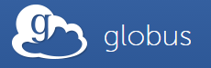



How to realize our RDM Platform
RDM
Platform
Establish corroborative development with the Western projects
Our Functional Requirements
  Connection to Institutional Storage Service
  Institutional Level Control Panel (Storage Configuration, Plugin Configuration)
  SAML Authentication and connect with VO Platform
  Metadata Management Functionality
  Easy deposit function to JAIRO Cloud
  Mash-up with other scholarly information services in Japan
Advantage of OSF is its “Flexible” and “Extensible” architecture

Slide 46
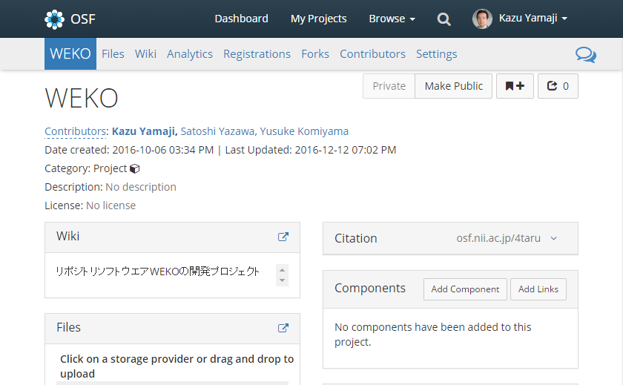
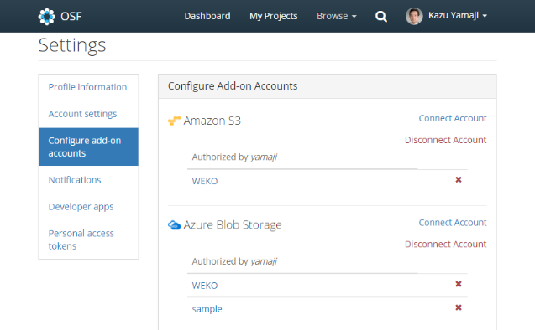
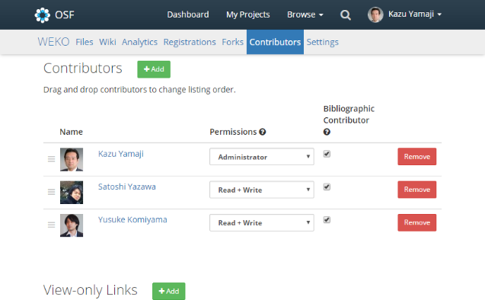

New Service
RDM
Platform
Manage Research Data
by Research Project
Connect Cloud Storage
from Various Plugin
Share Research Data within
Collaborators authn by ID Fed
NII: Frontend Service
RDM Platform
University: Backend Storage
Cloud Storage
NII Storage
Customize selectable Plugin depending on
University Environment and Policy
Default (minimum?) Storage by NII
Public Cloud
(Provider DC)
Private Cloud
(On-premise)
Public Cloud
(Provider DC)

Slide 47
New Functions Developed in FY2017
RDM
Platform
New Plugin
  New External Storage
    ownCloud, S3 Compatible Storage, OpenStack Swift
  Integration with Publication Platform
  Integration with Data Analysis Tool
    JupyterHub
  Plugin SDK
Research Data Management
  Research Footprint Management
  Metadata Management
  Workflow Management
Institutional Management
  Plugin Selection
  Statistics
  Institutional Template

Slide 48
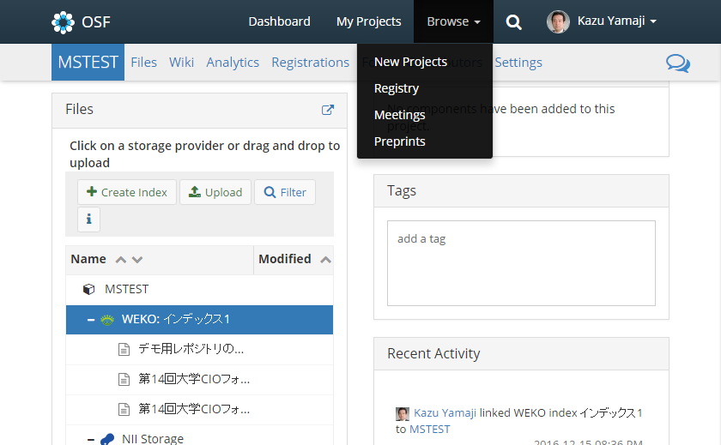
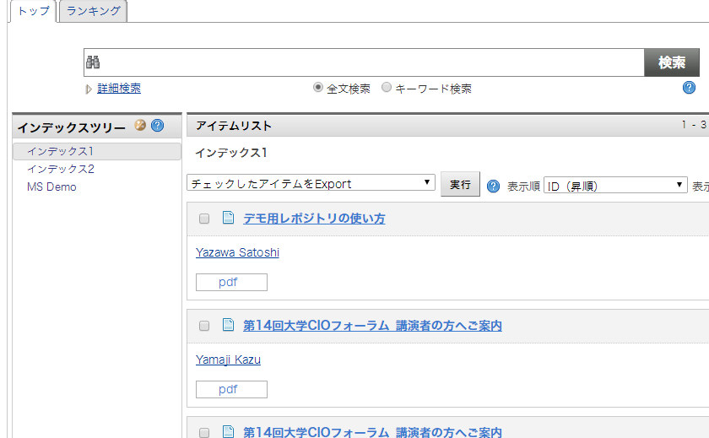

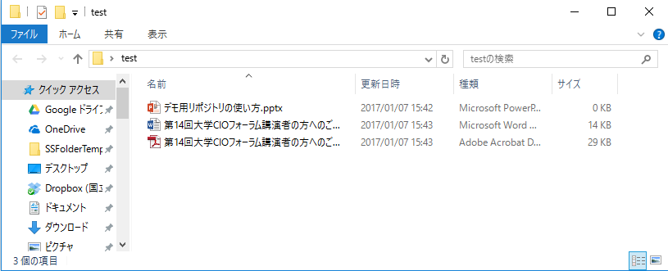
Integration with Publication Platform
RDM
Platform
RDM Platform
Publication Platform
Repository
Plugin
Researcher
File Management
Timestamp Proofing
Long-term Preservation
…
Librarian, Research Office
Metadata Management
Data Publication
DOI Registration
…

Slide 49
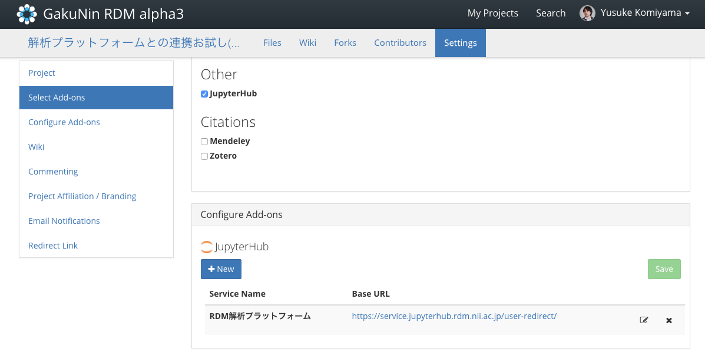
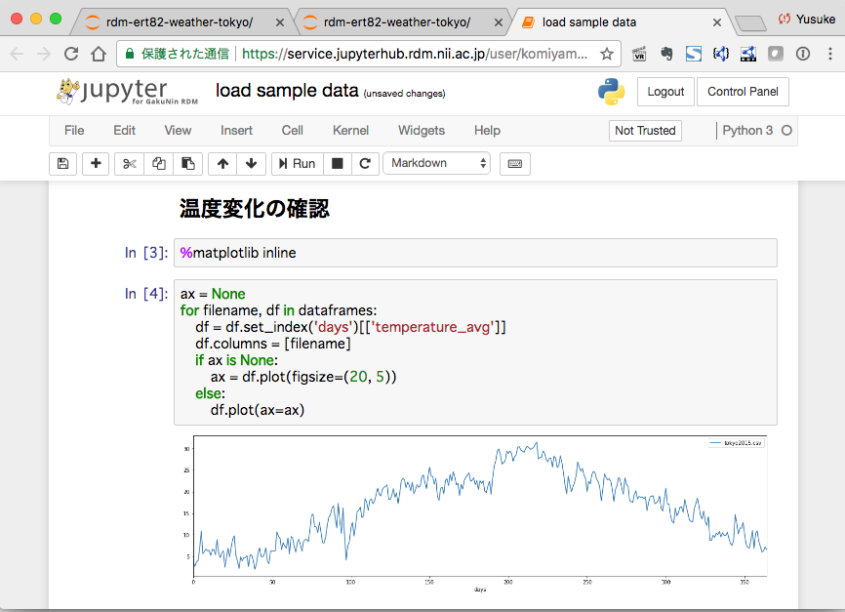
Integration with Data Analysis Tool
RDM
Platform
JupyterHub
・Programming
・Execution
Connect
GakuNin RDM
・Storage
・Repository
（2018年12月実装）
GakuNin RDM add-on for Data Analysis Tool: JupyterHub
Easy to Data Transfer between GakuNin RDM and JupyterHub
GakuNin ID Federation allow uses Single Sign On between Systems

Slide 50
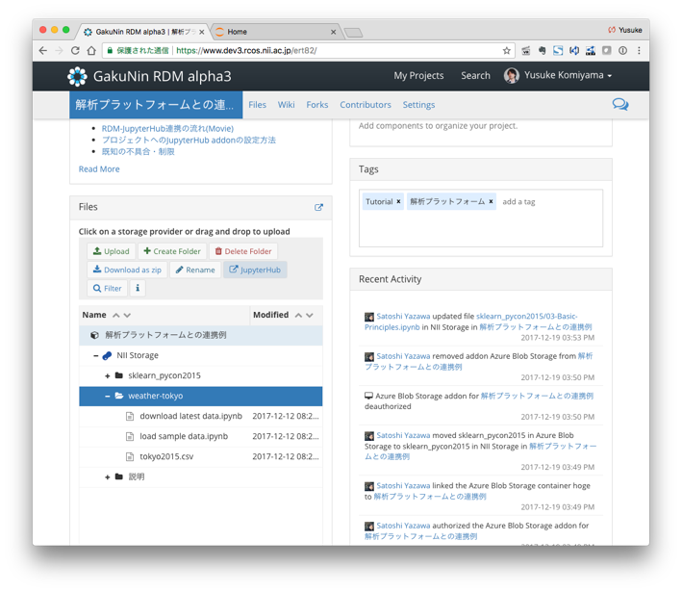
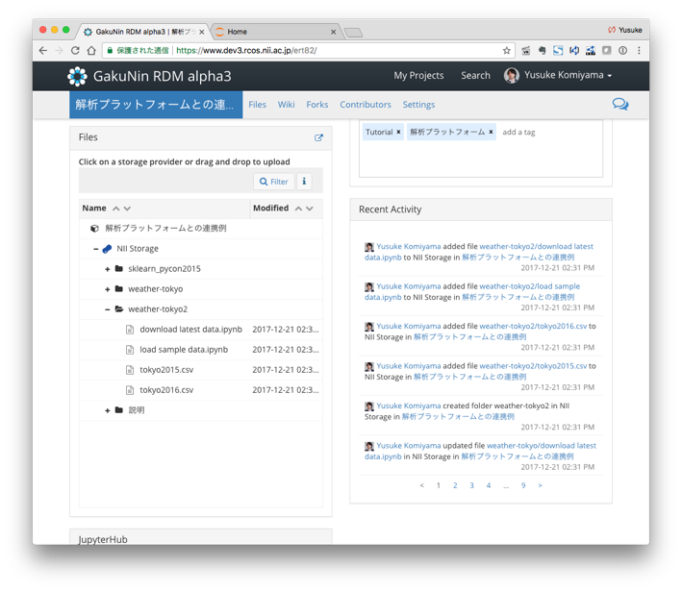
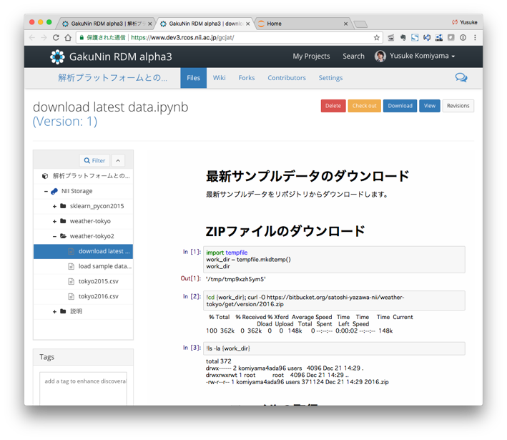
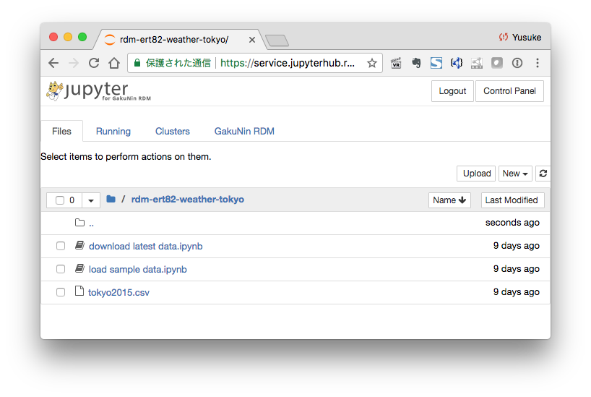
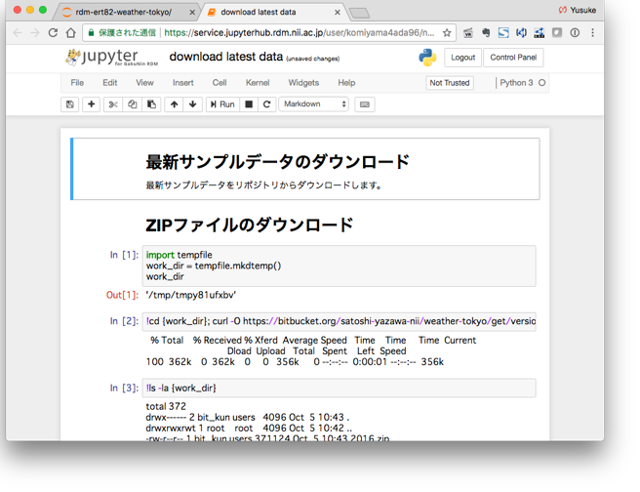
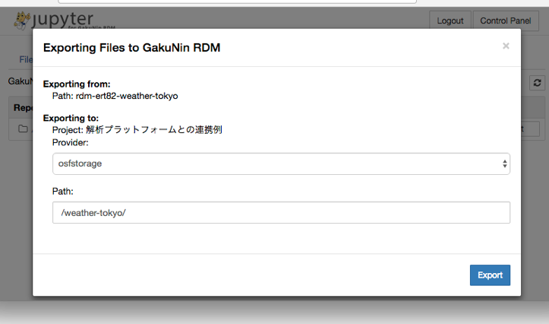
How to Use JupyterHub add-on
RDM
Platform
GakuNin RDM
Raw Data
Analyzed Data
Confirmation
Data transfer from GakuNin RDM to JupyterHub
(5) Check transferred files back to GakuNin RDM
(6) GakuNin RDM can preview IPython Note Book (ipynb) file format
JupyterHub
Input
Data Analysis
Result
(2) Check transferred files to JupyterHub
(3) Programming and Execution
(4) Result feedback from JupyterHub to GakuNin RDM

Slide 51
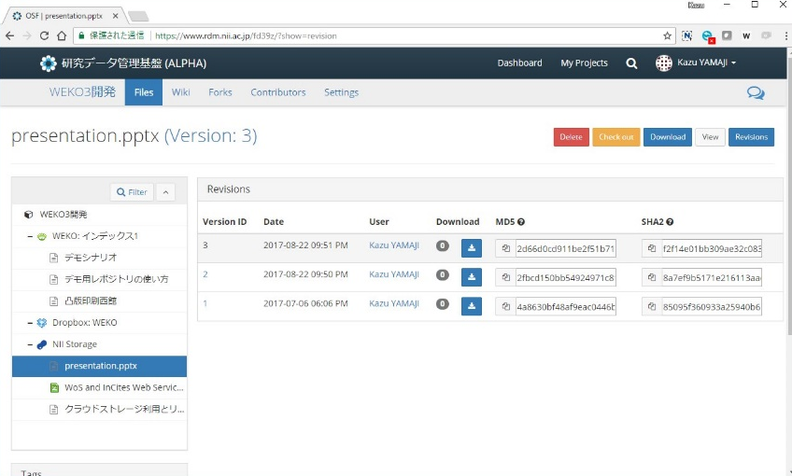



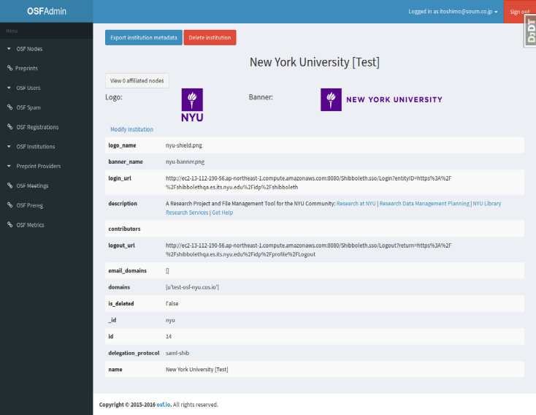


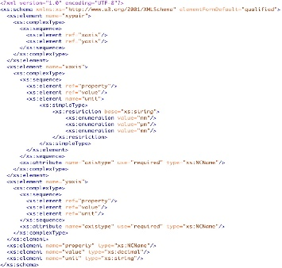

Research Footprint Management
データ管理基盤
商用時刻認証局
Time Stamping
Authority
機関管理
国立情報学研究所[Test]
Project Log
Institutional
Log
Time Stamp
2007.11.8
10:05:32

Slide 52
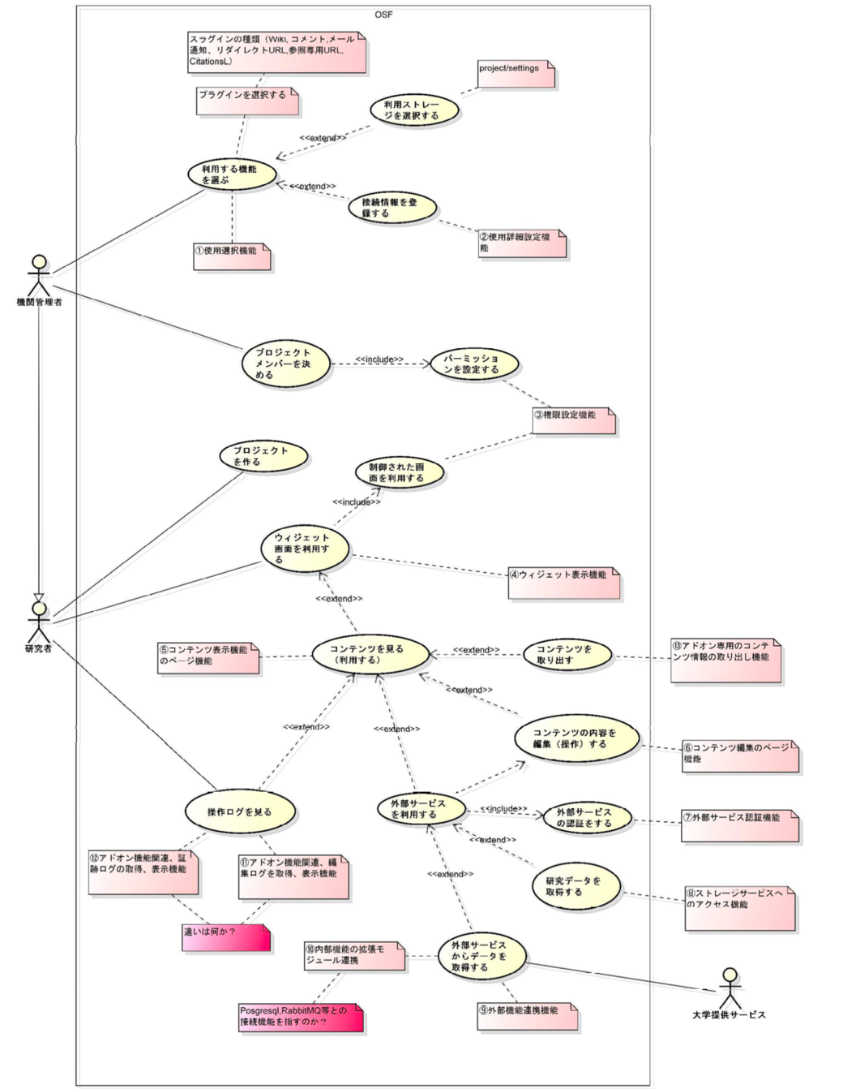
Plugin Software Development Kit
RDM
Platform
Why
  Default Functions = Common Use Case
  Respective Demand in Institutions
  Provide GakuNin Plugin SDK
Libraries
・Available Function Selection
・Storage Selection
・Token Registration
・Project Member Definition
・Permission Definition
・Project Creation
・Widget Screen Function
・Controlled Screen Function
・Content View
・Content Export
・Content Edit
・Log View
・External Service Selection
・External Service Authentication
・External Service Data Aggregation

Slide 53
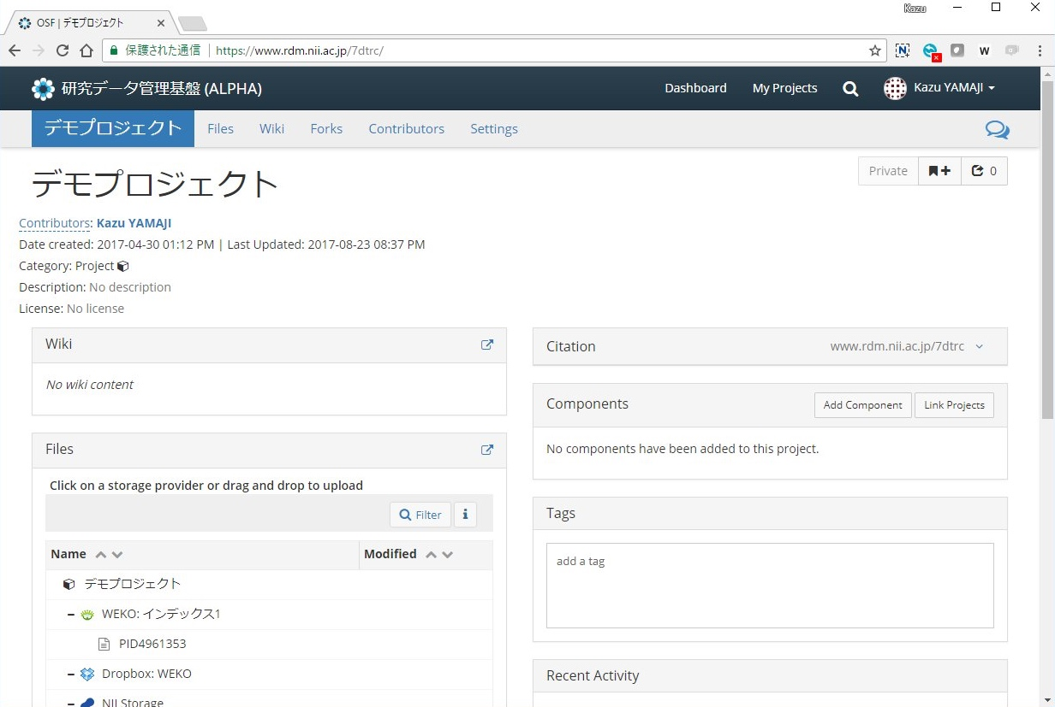
Screen Image with New Plugin
RDM
Platform
New Plugin
Develop New Plugins in Cooperate with Universities and Research Institutes
Create Developer's Community of GakuNin RDM

Slide 54
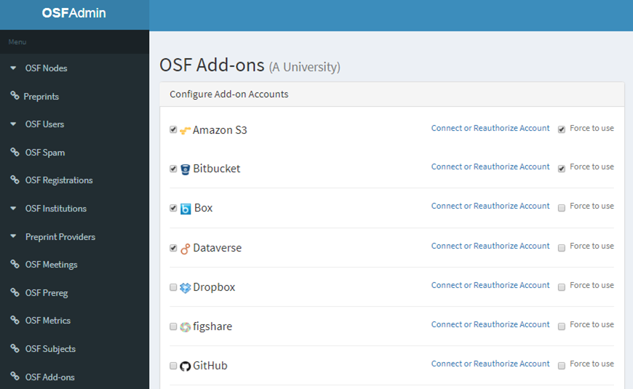
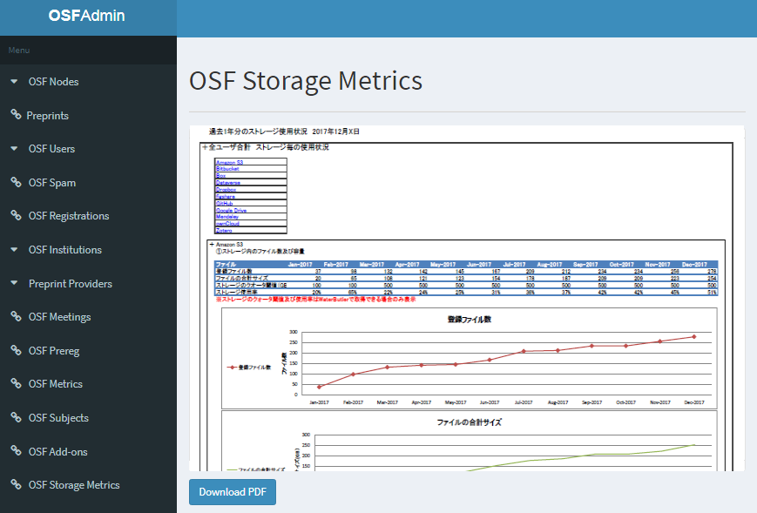
Institutional Management Function
RDM
Platform
Select Institutionally Available Storage
Select Authorized External Services
Download Institutional Logs

Slide 55

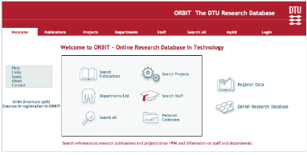
Use Case of GakuNin RDM in Institution
RDM
Platform
A Laboratory
GakuNin RDM is now developing function which can customize available plugin and workflow depending on respective requirement in each institution
New Project
DMP
Exp. and Anal.
Analysis Tool
New Evidence
Plagiarism Checker
B University
Writing Paper
Publication Management Plugin
Acceptance
CRIS DB
Paper & Data Deposit
Publication

Slide 56





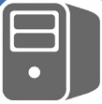
How to deploy GakuNin RDM
RDM
Platform
Source Code
Deploy Tools
Development
Open Source
Standard
Enterprise
For institution who want to operate On-Premise manner GakuNin RDM
Provide source code and documents
Share operation knowledge
SaaS service from NII by using public cloud
Enable to use institutional storage by connecting GakuNin RDM
GakuNin authentication
For institution who cannot use NII’s SaaS service due to institutional policy
Provide deploy code or direct deploy from NII
Use Institutional IdP
Considering Several Option according to the Institutional Policies

Slide 57




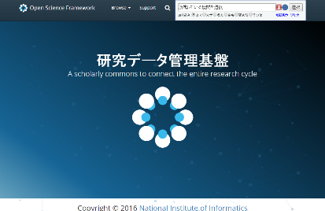

Internal and External Collaboration
RDM
Platform
University IT Center
(System Requirement, Operation Policy)
University Library
(RDM Training)
International
AXIES
Research Data Management WG
JPCOAR
Research Data TF
Research Center for Open Science and Data Platform
R&D Center for
Academic Networks
Center for Cloud R&D
Academic Authentication
Systems Office
Secure NW
Service Deployment
Storage Procurement
Data Analysis Infra.
ID Federation
VO Platform

Slide 58
Collaboration with Research Institutes
RDM
Platform
Material Science
  NIMS, Data Platform Center
Aerospace Science
  JAXA, Security and Information Systems Department
  The University of Aizu,
  Research Center for Advanced Information Science and Technology
Astronomy
  National Astronomical Observatory of Japan,
  Astronomy Data Center
Social Science
  Rikkyo University, Center for Statistics and Information
Medical Sciences
  The University of Tokyo, The Institute of Medical Science
Agriculture
  NARO, Institute for Agro-Environmental Sciences
Meeting
Discussion
Experiment
Feedback
Early Adopter
Collaboration
Community

Slide 59
Experimental Plan with Universities and Research Institutions
RDM
Platform
αTesting#1 : March 2017
  Object：Obtain feedback from IT Center in Large Scale Institutions
  Participants : Hokkaido University, Tohoku University, Kyoto University, Osaka University Kyushu University, Nagoya Institute of Technology,
  National Institute for Environmental Studies.
αTesting#2 : October 2017 (on-going)
  Object : Obtain feedback from Laboratory Use Case
  Participants : The University of Tokyo, Nagoya University, Tsukuba University, Keio University, Aizu University, Fukushima Medical University, RIKEN, JAXA
βTesting#1 : May 2018
  Object : Middle Scale Experiment by adopting New Functions developed in 2017
Institutional Feasibility Study : July- 2018
  Object : Obtain feedback from Institutional and Domain Specific Use Case

Slide 60
Relationship between Research Data Infrastructure and Research Workflow
Discovery Platform
RDM Platform
Project Start (Application)
Member Management
Initial Setting
Aggregation
Experiment
Data Acquisition
Publication Platform
Institutional or
Domain
Repository
Data Management
Data Analysis
Paper writing
Deposit with Supplemental Data
RDM Platform

Slide 61
Deployment Plan
FY2016
  Initial Development
  αTesting with major Universities
FY2017
  System Development
  Small Scale Feasibility Study (βTesting)
FY2018
  Large Scale Feasibility Study
FY2019
  Pilot Operation
FY2020
  Production Operation
RDM Platform
Publication Platform
Discovery Platform

Slide 62
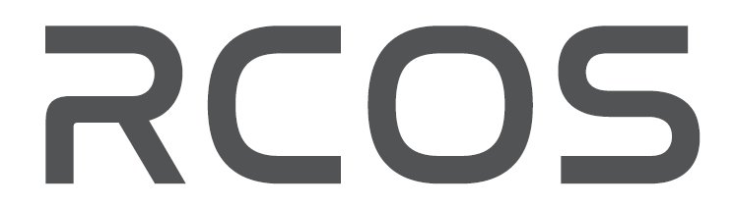
yamaji@nii.ac.jp

