Slide 1
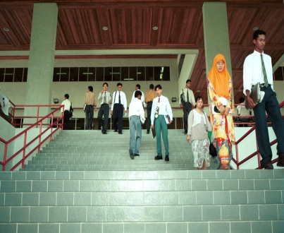
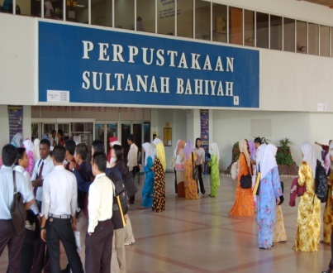
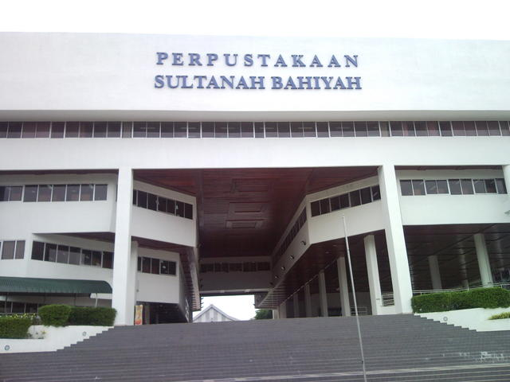
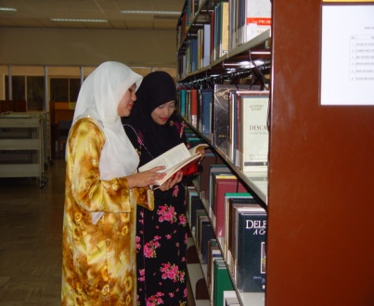
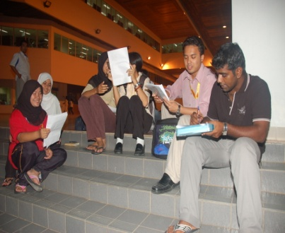
STATUS & DEVELOPMENT OF
INSTITUTIONAL REPOSITORIES IN MALAYSIA
[PUBLIC & GLC UNIVERSITIES]
SALLEH HUDIN MUSTAFFA
UNIVERSITI UTARA MALAYSIA

Slide 2


Slide 3
Institutional Repository
A university-based institutional repository is a set of services that a university offers to the members of its community for the management and dissemination of digital materials created by the institution and its community members. It is most essentially an organizational commitment to the stewardship of these digital materials, including long-term preservation where appropriate, as well as organization and access or distribution.” (Lynch,2003)
  URL: http://www.arl.org/bm~doc/br226ir.pdf)
An institutional repository is a type of digital library that "capture[s] the original research and other intellectual property generated by an institution's constituent population active in many fields" (Crow, 2002)
  URL : www.sparc.arl.org/sites/default/files/ir_final_release_102.pdf

Slide 4
IR in Malaysia
Academic Library is the largest group of library in Malaysia that has successfully built the IR, compared to other type of libraries.
From overall 20 Public Higher Education Institutions (Public HEIs) in Malaysia, 19 Public HEIs have successfully developed the IR, except Universiti Pertahanan Nasional Malaysia (UPNM).
From overall 19 PHEIs, only 3 Public HEIs successfully developed more than 1 IR:
  UKM = 2 IRs (PTSL UKM Repository & UKM Journal Article Repository)
  UM = 5 IRs (Commonrepo UM, Dspace@UM, UM Research Repository, UM Students Repository & MyManuskrip)
  UUM = 2 IRs (UUM Repository & UUM ETD Repository)
From overall 458 Private Higher Education Institutions (Private HEIs) in Malaysia, only 6 Private HEIs have successfully developed the IR . The Private HEIs are UTP, MMU, UTAR, UniKL ,UNITEN, & SUC. Only UTP successfully develops 2 IRs (UTP-IR & UTPedia), while the rest have only one.
Source: Katrun Nada, Zahuddin (2015). Institutional Repository For Sustainable Advancement: Malaysian Experience [Powerpoint slides]. Retrieved from https://www.slideshare.net/zdayne1/institutional-repository-for-sustainable-advancement-a-malaysian-experience-zahuddin-sidek

Slide 5
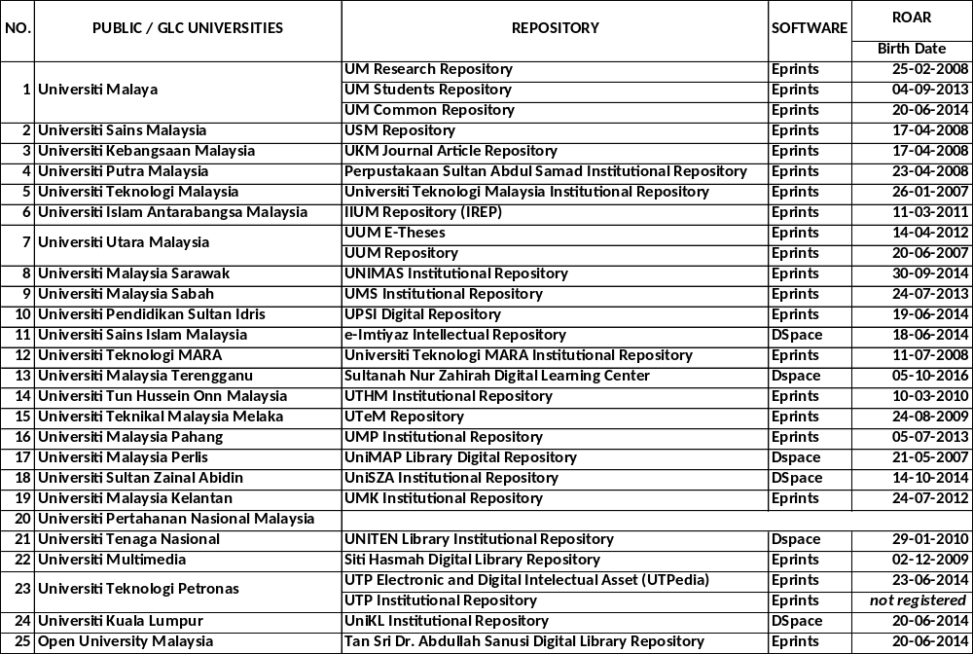

Slide 6
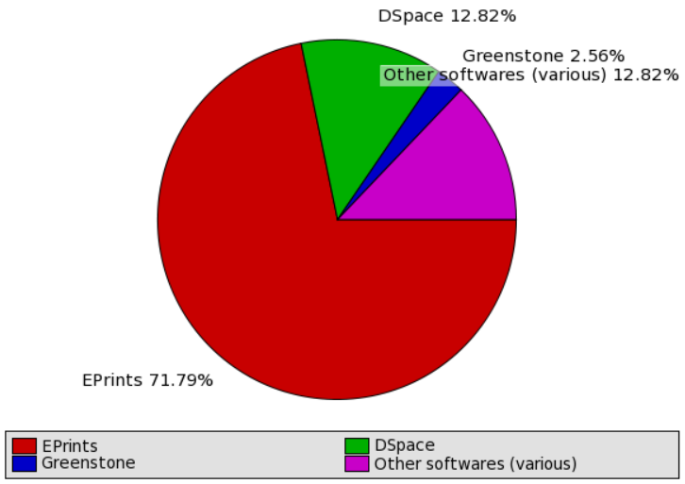

Slide 7
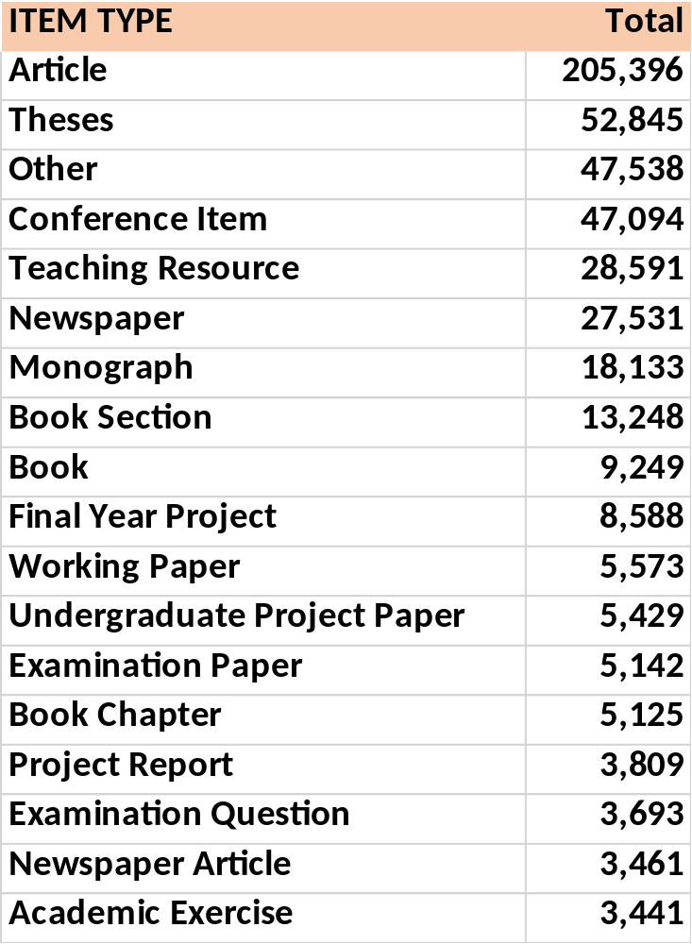
ITEM TYPES ?
Working papers
Research reports/technology reports
Datasets
Supplementary materials
Learning objects
Multimedia collections
Papers in support of grant applications
Committee reports and memoranda
Statistical reports
Technical documentation
Surveys
Electronic Portfolios
Images, Video and audio files
Others _______________

Slide 8
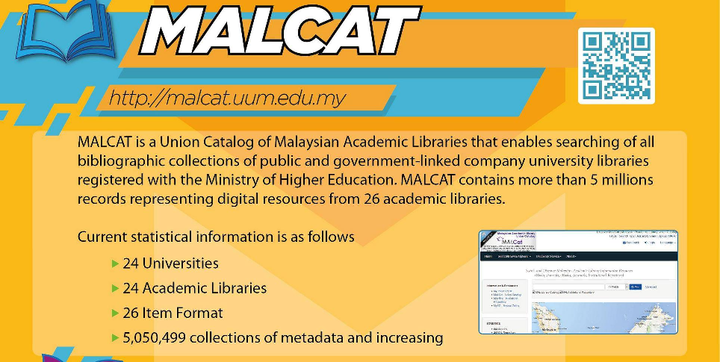
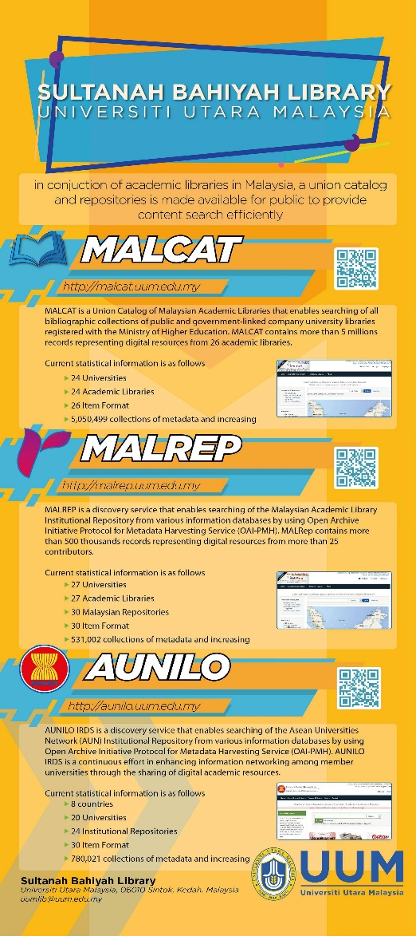
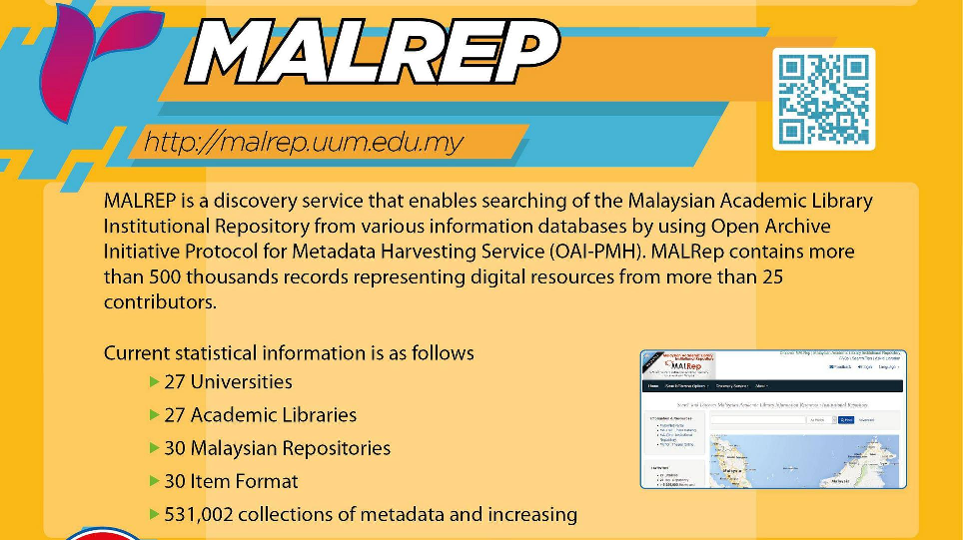

Slide 9


MALREP DISCOVERY SYSTEMS
UniMAP
USIM
UM
UNITEN
UPM
UNITEN
UTeM
UMK
UTM
UTHM
UniKL
Solr index
UKM
USM
HARVEST
UiTM
search
index
UIAM
UMT
HARVEST
UUM
MMU
UTP
UniSZA
Search
Search
Search
Search
Search
Search
Search
Search
UMS
UPSI
UNITAR
UNIMAS
UMP
INTI & Sunway
OUM
Users

Slide 10
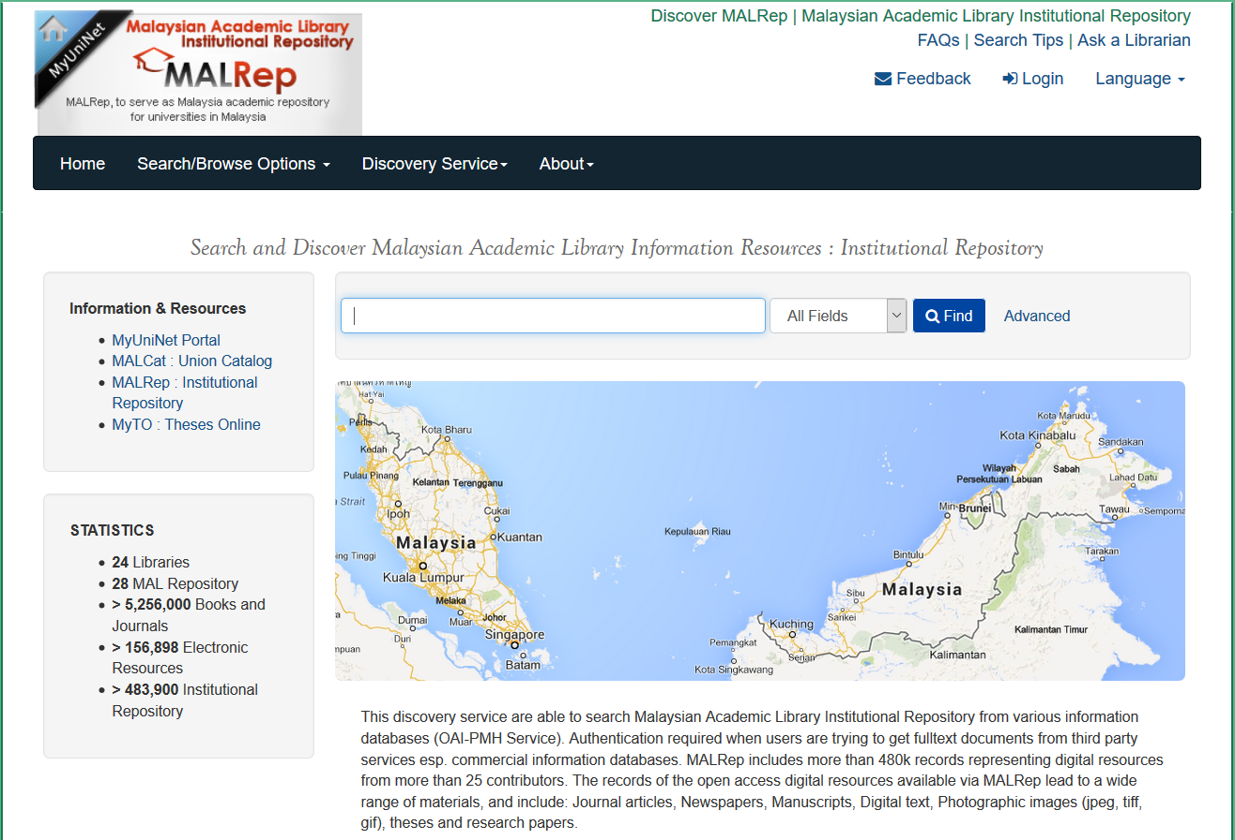

Slide 11
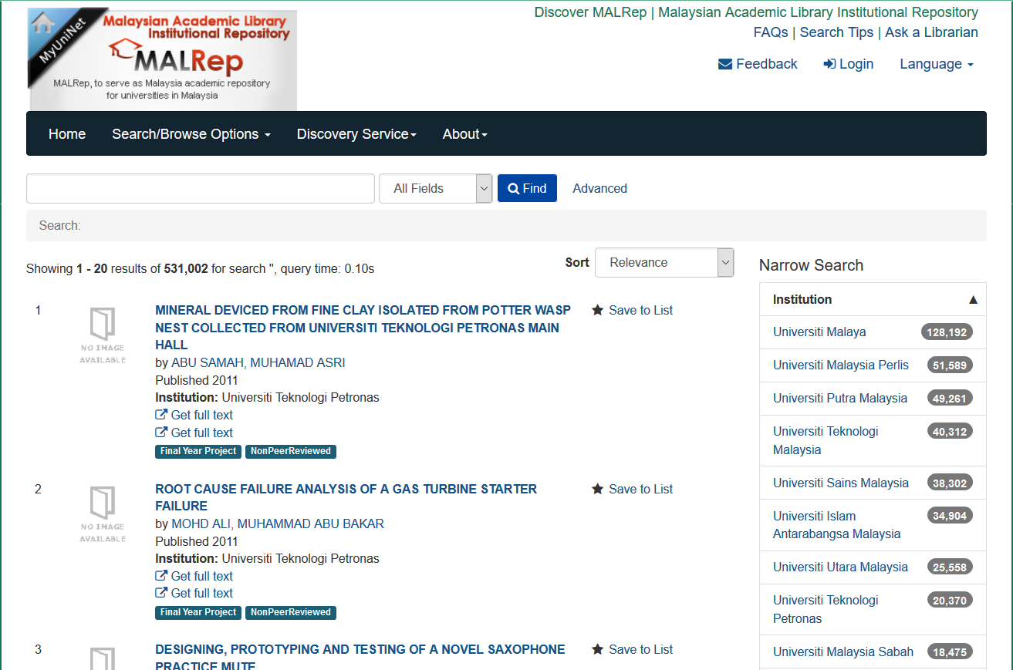

Slide 12
Digital Knowledge Repository ?
Strengthen existing collection in IR
Create guideline for standardization (types, description, metadata elements, language code, etc.)
University IR… new document type?
Introduce new features to ease users, ie translation [cn → en]
Content development approach : from in-house efforts to collaborative efforts
Provide rich metadata descriptions….. Social bibliometric analysis
ReUse public domain data and information
ReThink: Knowledge Repository vs Institutional Repository (scholar) vs Digital Repository vs Digital Assets Repository

Slide 13
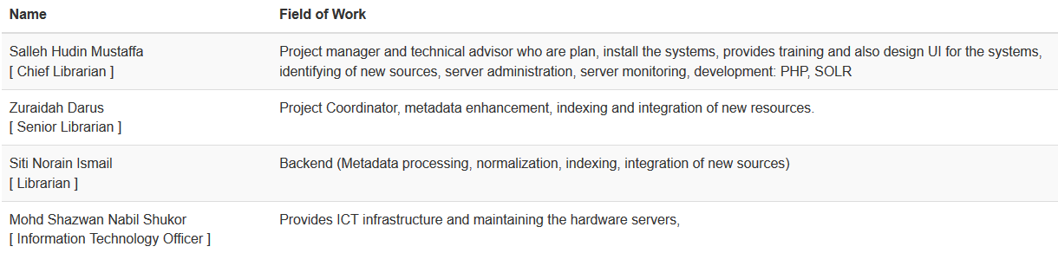



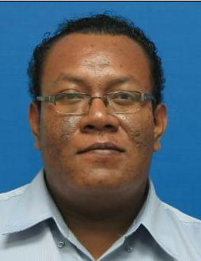
MALRep: Technical Team
Have Question?
Need Answer ?

Slide 14
STATUS & DEVELOPMENT OF
INSTITUTIONAL REPOSITORIES IN MALAYSIA
[PUBLIC & GLC UNIVERSITIES]
-: THANK YOU :-

